Slide 1
ERASMUS +
Smart Mobility

Slide 2
Relevance

Slide 3
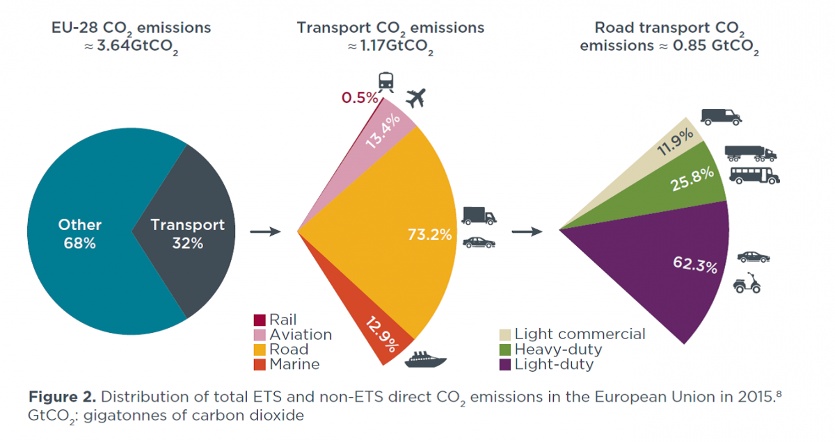
Smart Mobility- Greenhouse Emission
Traffic produces a huge amount of greenhouse gases
2020: 160 million tons of CO₂ only by traffic

Slide 4
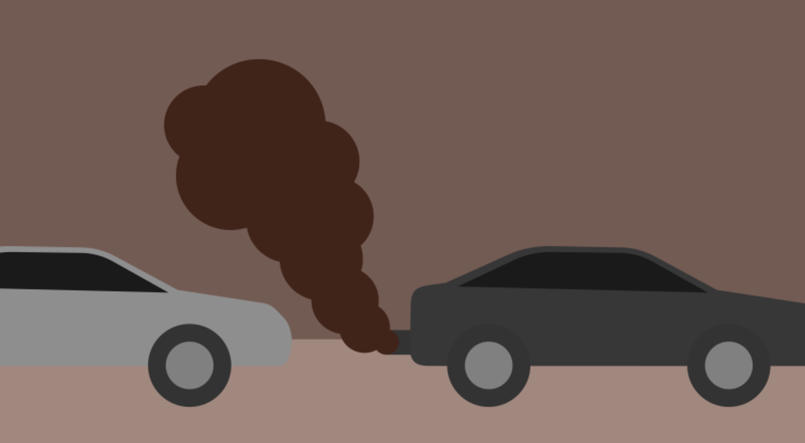
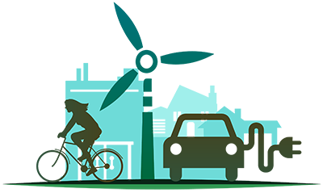
Climate Protection Act
Goal:​
decrease greenhouse emission by 65% till 2045
have zero greenhouse gas emission till 2050

Slide 5
Guide
Overall Concept for:
an environmentally oriented organization
institutionalization of cross-mode infrastructure financing in Germany
GUIDE:
currently in its planning phase
build on three pillars

Slide 6
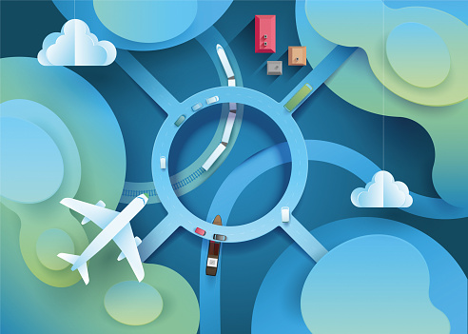
The Pillars
First Pillar
To create a nationwide transport infrastructure association, which is to be responsible for cross-traffic planning of road, rail and water infrastructure.
Second Pillar
Consistent user funding for
the maintenance of the transport infrastructure.
Third Pillar
External environmental costs arising from emissions will be internalized.
The users of motorways, railways and waterways are supposed to be charged.

Slide 7
What is Smart Mobility?

Slide 8
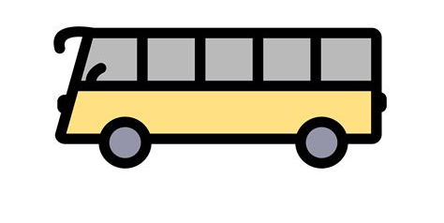
Definition
rethinking of transportation infrastructure
intelligent transport network
new modes of transportation
sustainability
efficiency

Slide 9
Partnership Project Smart Mobility 2.0
Vida Scuola Riga
Hellenstein-Gymnasium
Colegiul National Bilingv Georg Cosbuc
Institut Guindàvols
Istituto di Istruzione Superiore “G. La Pira”
carry out achievable solutions
create ideas
meet new people
activities & health

Slide 10
Smart Mobility at the Hellenstein Gymnasium

Slide 11
Our ideas for Smart Mobility
SUSTANIABLE CLASS TRIPS
CYCLE TOGETHER TO SCHOOL
EUROPEAN TRAIN TICKET

Slide 12
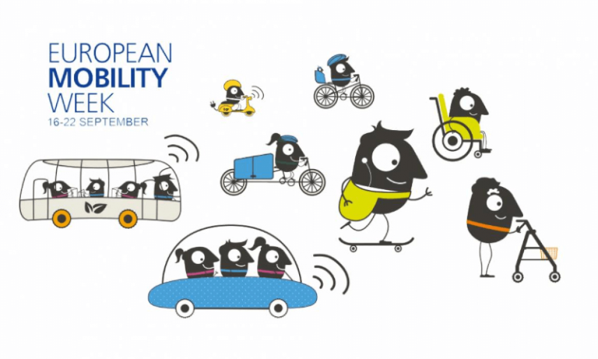
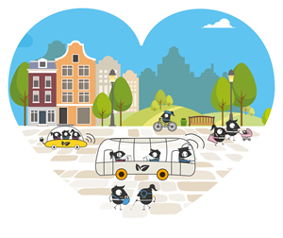
What is the „European Mobility Week“?
awareness-raising campaign
every year from 16 to 22 September
encourages behavioural change
3184 towns and cities registered in 2021
652 new mobility actions registered in 2021

Slide 13
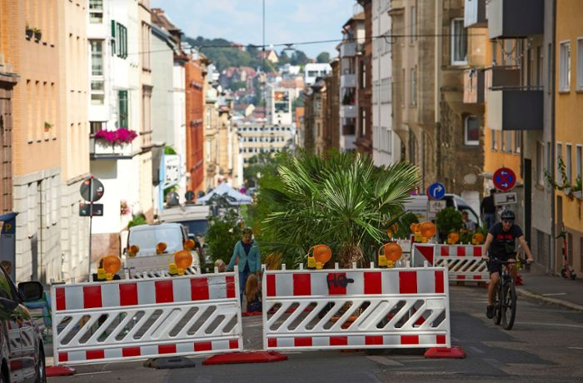
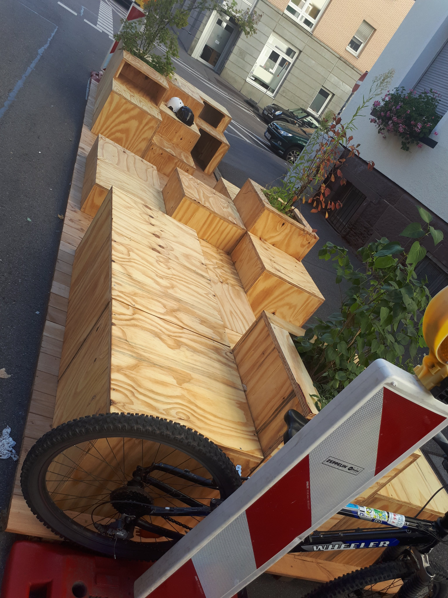
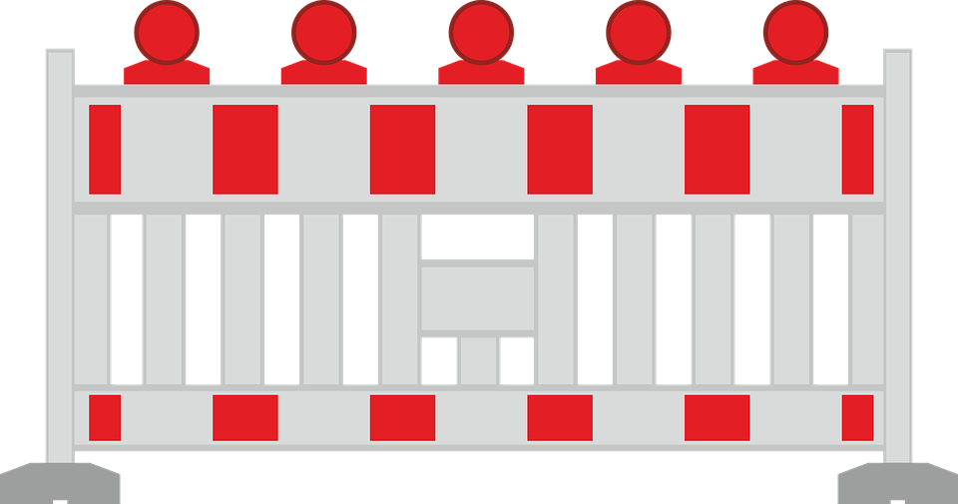
EMW 2021
Topic N°1:
Safe and Healthy with Sustainable Mobility
tribute to the environmental hardships felt by Europe
opportunities for change
Example: Stuttgart “Super Block”
residential blocks are barred to through traffic
they are crossed by pedestrian walks and offer place and space for communication and outdoor games

Slide 14
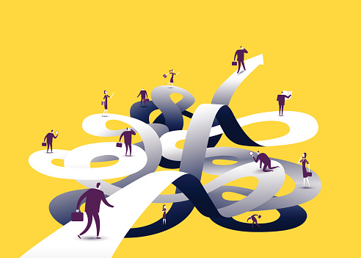
EMW 2021
Topic N°2:
Better connected:
connection of places
connection of people

Slide 15
EMW 2021
Topic N°2:
Better connected:
connection of places
connection of people
SEVERAL MAIN TOPICS

Slide 16
EMW 2022
Common goals:
more quality of life
more future viability

Slide 17
Solutions

Slide 18
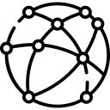
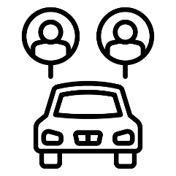
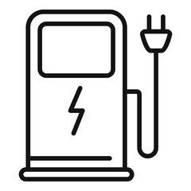
Requests and Solutions
Improve our public transport
-> more links
-> connection between city and village
E-Scouters
Bike sharing
Improve car sharing
Public transport
Sharing
Promote E-Mobility:
More E-Bus
More charching stations for E-Car
Digitalisation
E-Mobioity

Slide 19
Thank you for your attention!

Slide 20
Sources
ttps://www.wagrati.eu/photo/flagge-europaische-union-europaflagge-12999?lang=de (27.03.22)
https://mobilityweek.eu/home/ (27.03.22)
https://www.umweltbundesamt.de/ (27.03.22)
https://www.cleanenergywire.org/sites/default/files/styles/lightbox_image/public/images/factsheet/road-transport-emissions-iwkoeln.png?itok=RiSKdmqr
https://www.umweltbundesamt.de/themen/bundesverkehrswegeplanung-umwelt-klimafreundlich
https://www.umweltbundesamt.de/themen/verkehr-laerm/nachhaltige-mobilitaet
https://www.sparcs.info/what-is-new/news/smart-cities-celebrate-european-mobility-week-hashtag-wemovesmart

