Slide 1
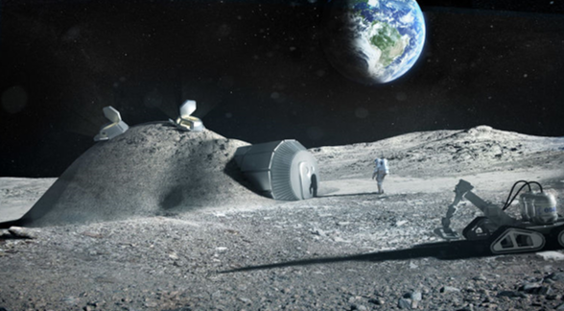
Smart mobility 2.0
´
Borrell Rosa, (Project coordinator), Cosialls Anicet, Picoy Pere, Quintillà Teresa, Vallabriga Anna and Vila Antoni

Slide 2
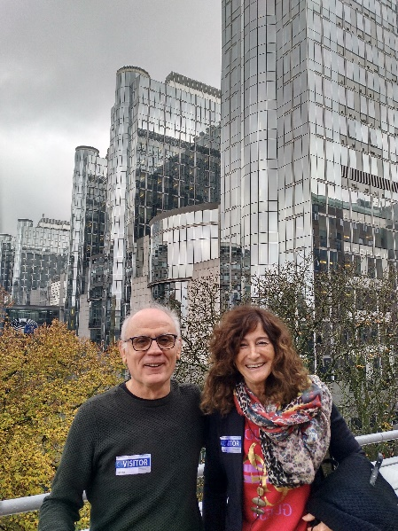
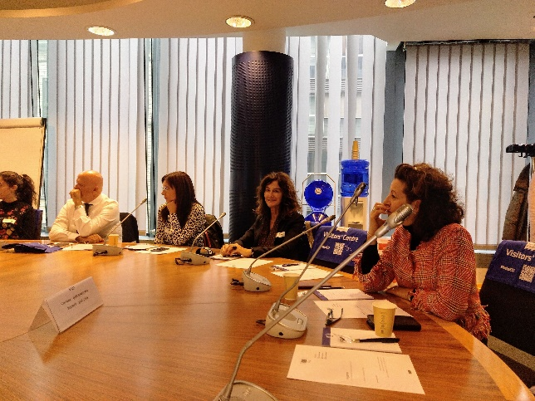
Preparing the project. November 2019, Brussels

Slide 3
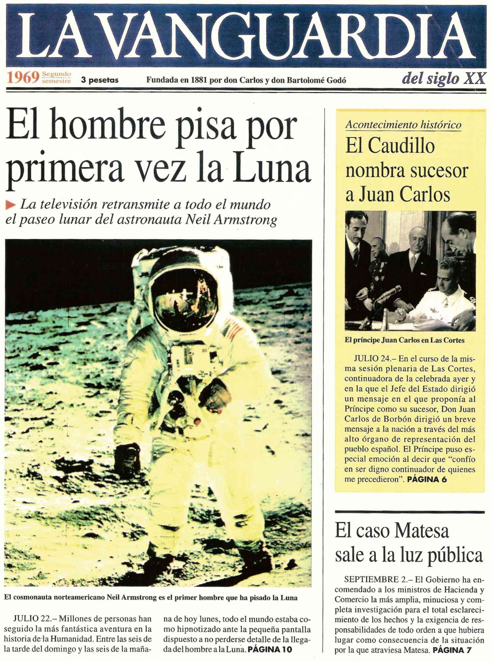

Slide 4
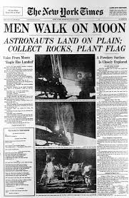
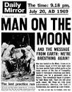
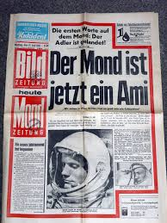
LOOK FOR DIFFERENT NEWSPAPER FRONT PAGES OF 21ST JUNE 1969
GERMANY
ITALY
LATVIA
ROMANIA
SPAIN

Slide 5
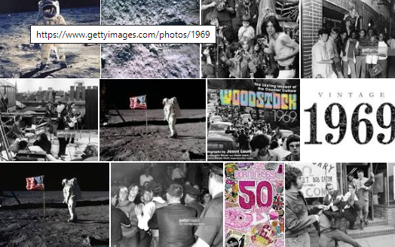
WHAT HAPPENED IN 1969 ALL OVER THE WORLD?

Slide 6
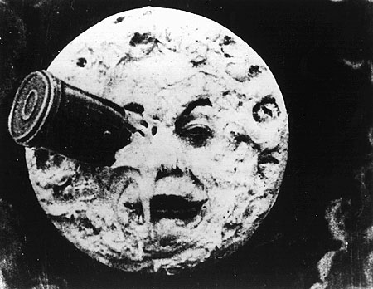
The Old Dream of Travelling to the Moon
1650
1865-1870
Georges Méliès,1903
Hergé,1953

Slide 7
Six Centuries of Galactic Adventure:
Copernicus
Giordano Bruno
Galileo Galilei
Johannes Kepler
Isaac Newton
In which ways did the contribute to the Space Adventure?

Slide 8
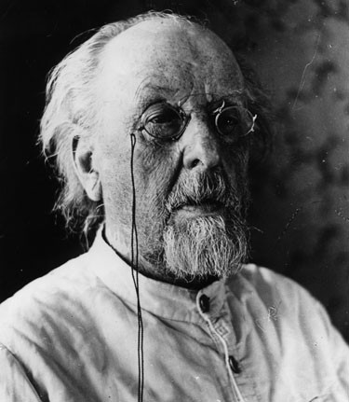
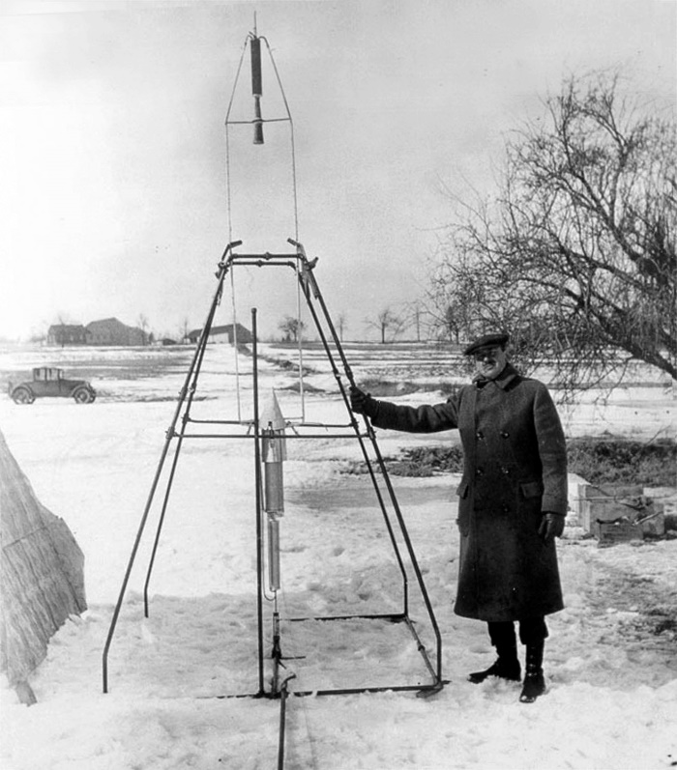
The Precursors of Modern Rockets
Konstantín Tsiolkovski (1857-1935).
Robert Goddard (1882-1945).
What did they do to be considered pioneers?

Slide 9
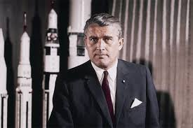
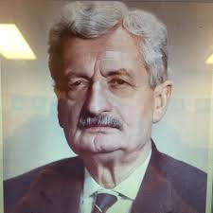
What about their contributions to Space Mobility?
Wernher von Braun
Hermann Julius Oberth

Slide 10
Why had nobody arrived to the Moon earlier than 1969?
Think about Possible ideas
A high speed is needed in order to escape from the Earth gravitatory field : 11,2 km/s (scape velocity).
Science was prepared to reach the Moon , Technology was not.
Rockest able to reach such a speed wrere needed.
The amount of money neede for such a Project was extreeemely high. Society at that time had to understand it was really worth travelling to the Moon.
The total cost of reaching the Moon was 25.000 million dollars at that time…. Was it relly worth?

Slide 11
Design a trip to the Moon

Slide 12
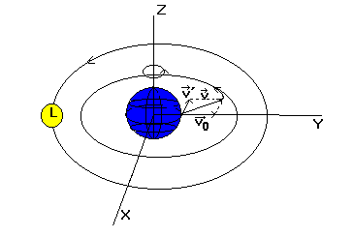
Where shall the rocket be launched from?
The Earth spins towards the East. The speed of rotation of the Earth has the highest peak on the Equator.
The launching bases are placed at the nearest position from 0 latitude.

Slide 13
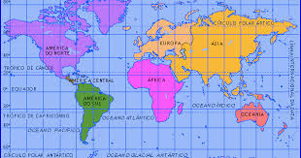
Draw the most important launching bases on the map

Slide 14
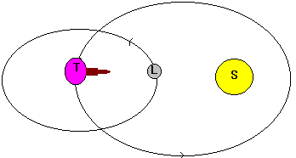
When should the rockect be launched?
Launching window
The attraction of the Moon and the Sun has to be favourable

Slide 15
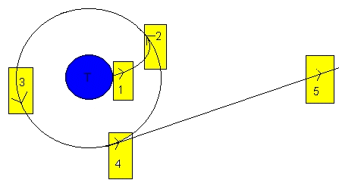
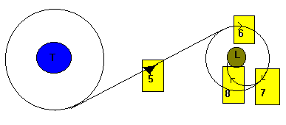
STAGES OF THE APOLO XI TRIP

Slide 16
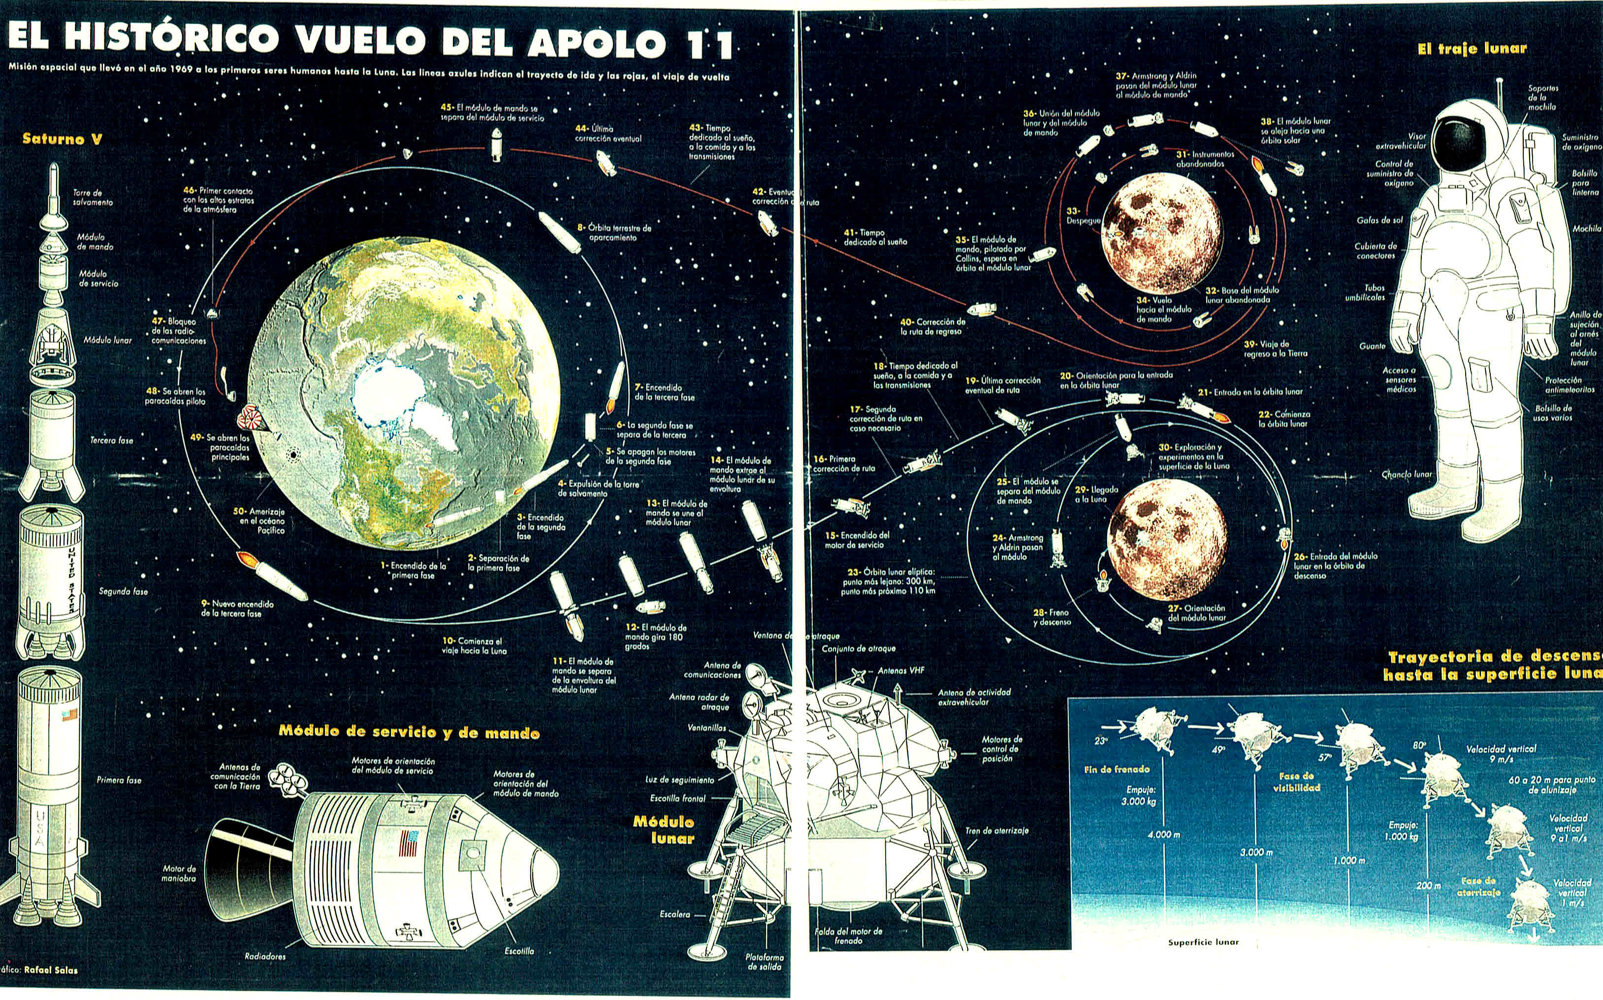
“La Vanguardia” 19th July,1994 Science and Technology

Slide 17
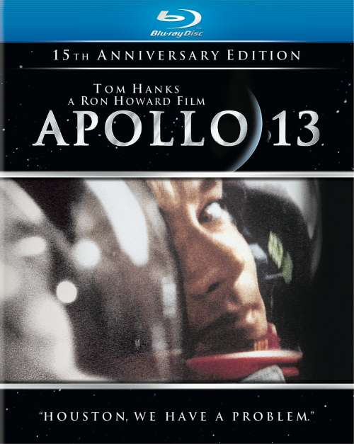

Slide 18
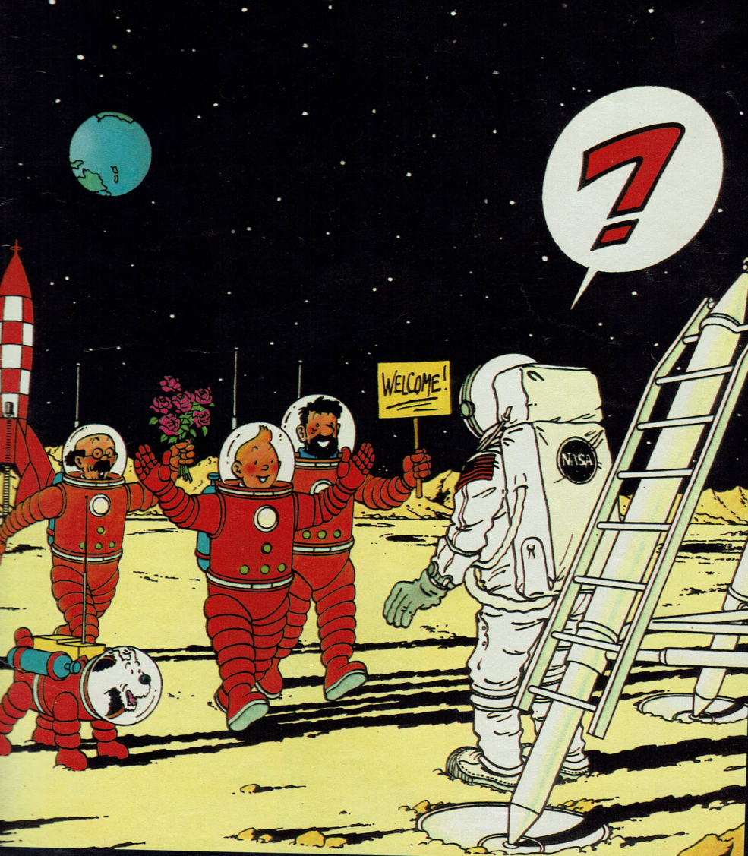
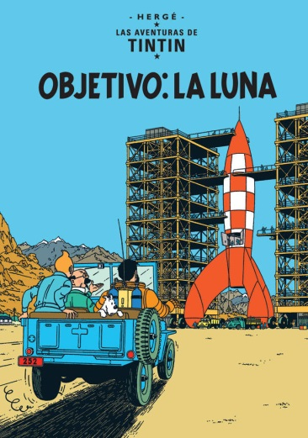
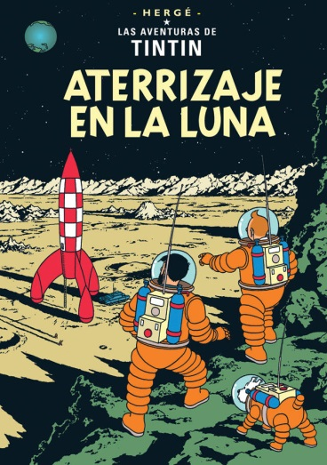
Tintín went 15 years ahead N. Armstrong .
“ Per primer cop a la història de la humanitat, un ésser humà acaba de trepitjar la Lluna! ” (Tintín)
“ És un pas petit per a un home, un salt gegant per a la humanitat!” (Armstrong)
Reality imitated fiction

Slide 19
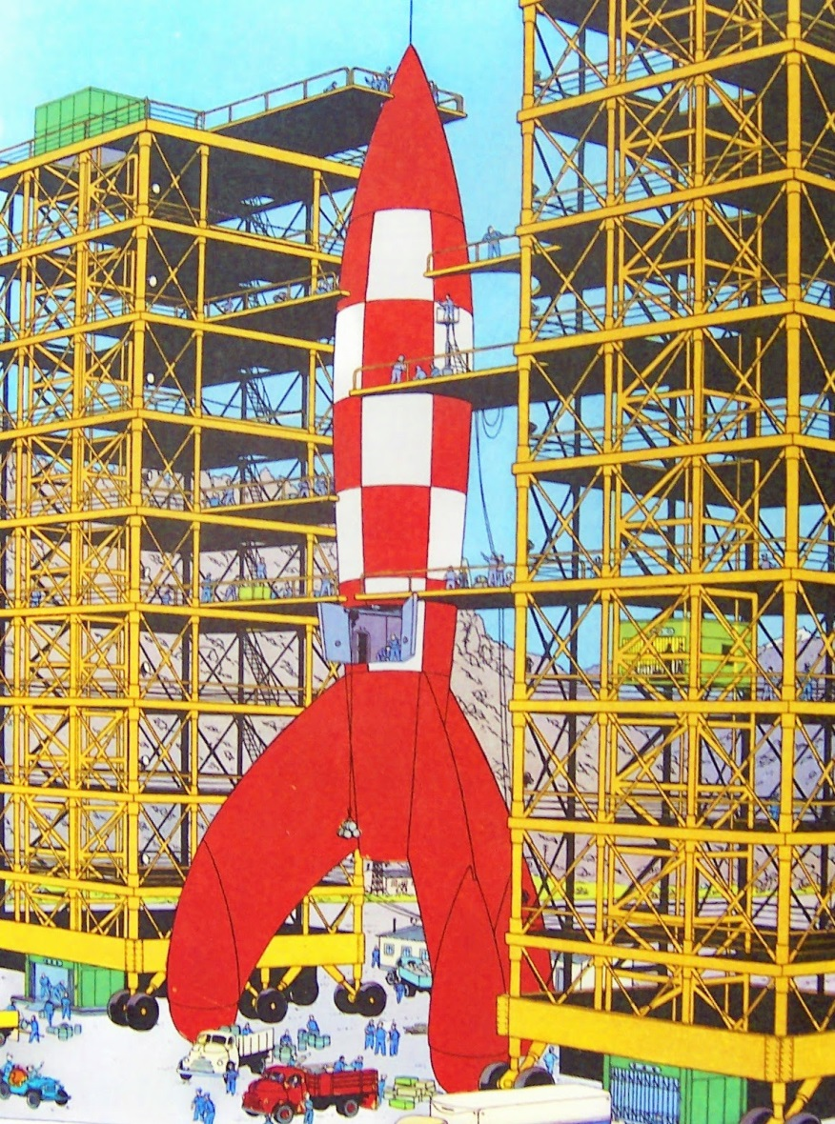
Ananoff supervised the model designed by Hergé
Hergé was advised by the scientist Piccard
One single section rocket.

Slide 20
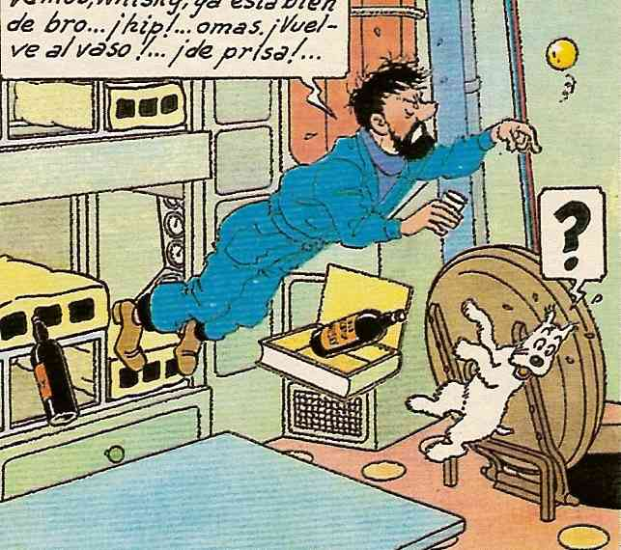
Ingravidesa o intoxicació etílica
Captain Haddock’s whisky becomes a ball when the rocket is without any gravity. The rocket remains weighless: this is the way fluids behave in absence of gravity.

Slide 21
LUNAR LANDSCAPE
Not a single bird neither a noise nor a cloud…
There are millions of stars shinning in a sky as black as iink , but they are immobilised , frozen, without any flickering movement as it is seen from the Earth.

Slide 22
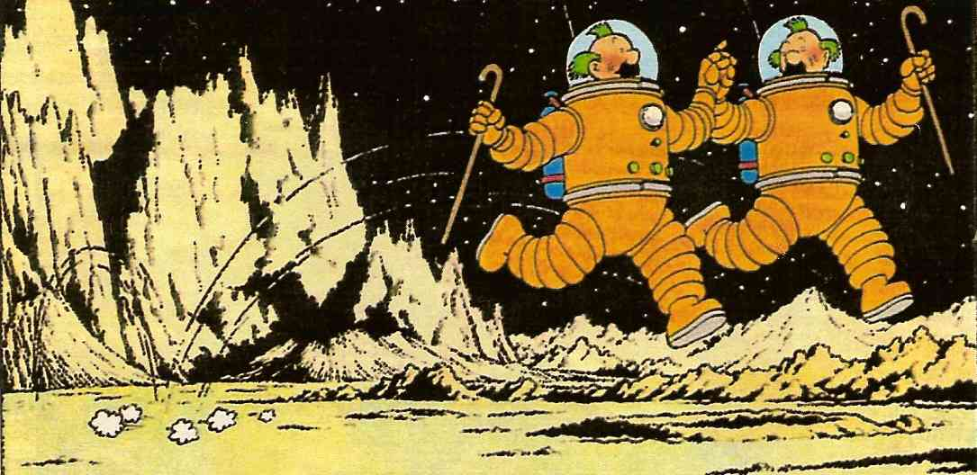
Ingravity , or better said reduced gravity -

Slide 23
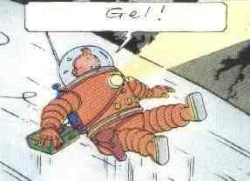
On 5th March 1998 the unmaned spaceship Lunar Prospector detected some ice on the Moon poles ,as Tintin had done.The old dream of colonising the MoonE may be true in a near future.

Slide 24
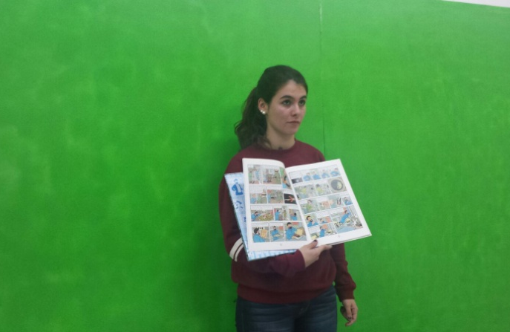
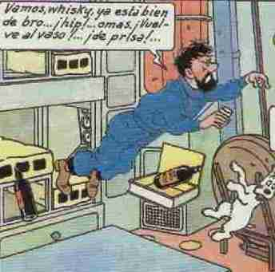
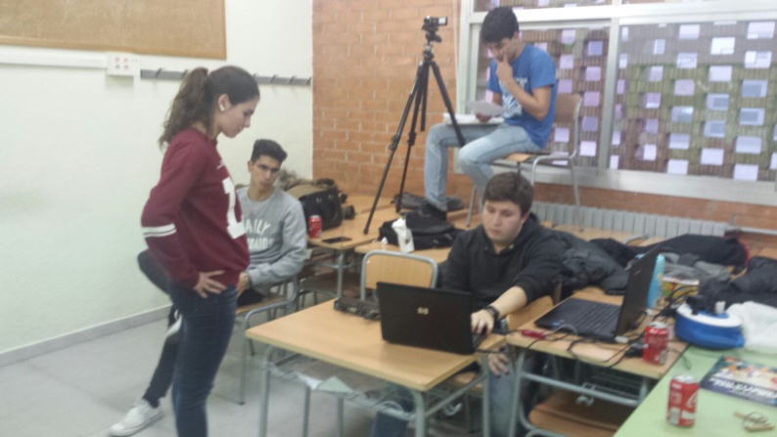
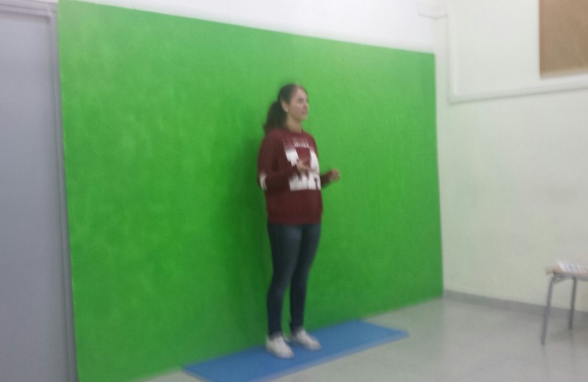
METHODOLOGY

Slide 25
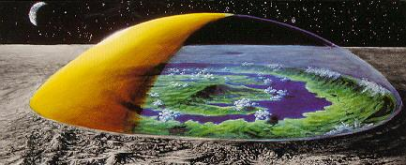
A city on the Moon
Where shall it be placeds? On the poles ? North pole? South pole’
What will be houses like?
And electricity? Where will it be from? And oxygen?
Where will people live? Where will they work?
Will it be worth to install an astronomic observatory? Will it be worth? And a Martian harbor?

Slide 26
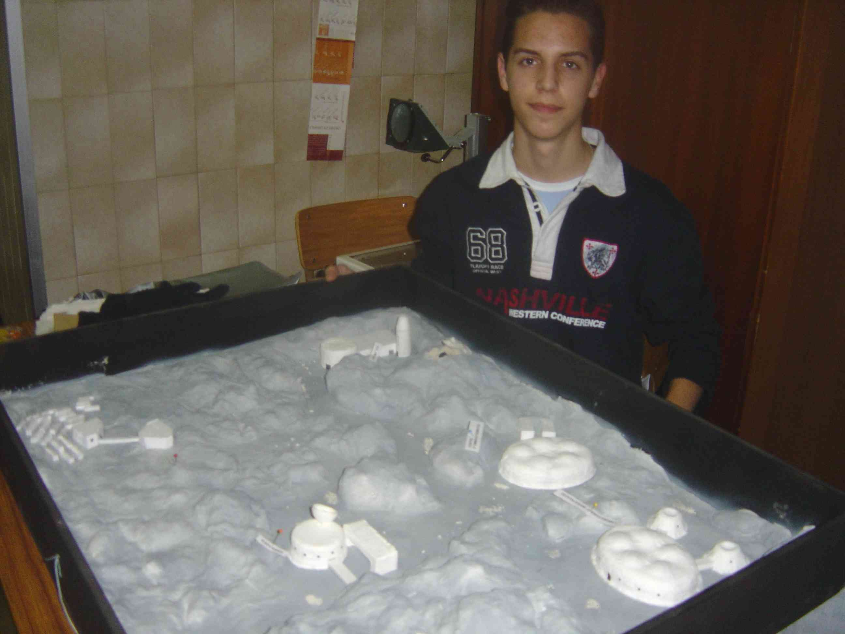
Design of a city on the Moon
Eduard Moreno. 2nd Baccalaureate

Slide 27
GUIDE FOR LUNAR TOURISM
How long does the trip take?
Can any person travel there?
Is there any needed training?
Which will be the temperature?
Which kind of clothing will be needed?
Which excursions will be recommended?
Will people be able to see Neil Armstron’s footprints?
Which will be the typical food?
Which medicines must be taken ?
If we like the landscape, will we be able to buy a piece of land?

Slide 28
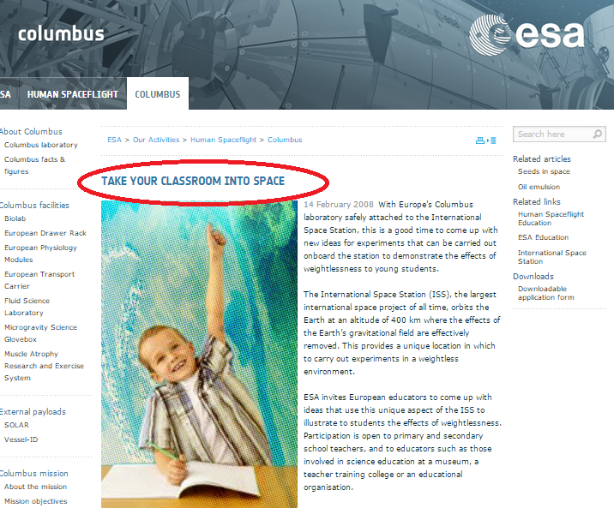

Slide 29
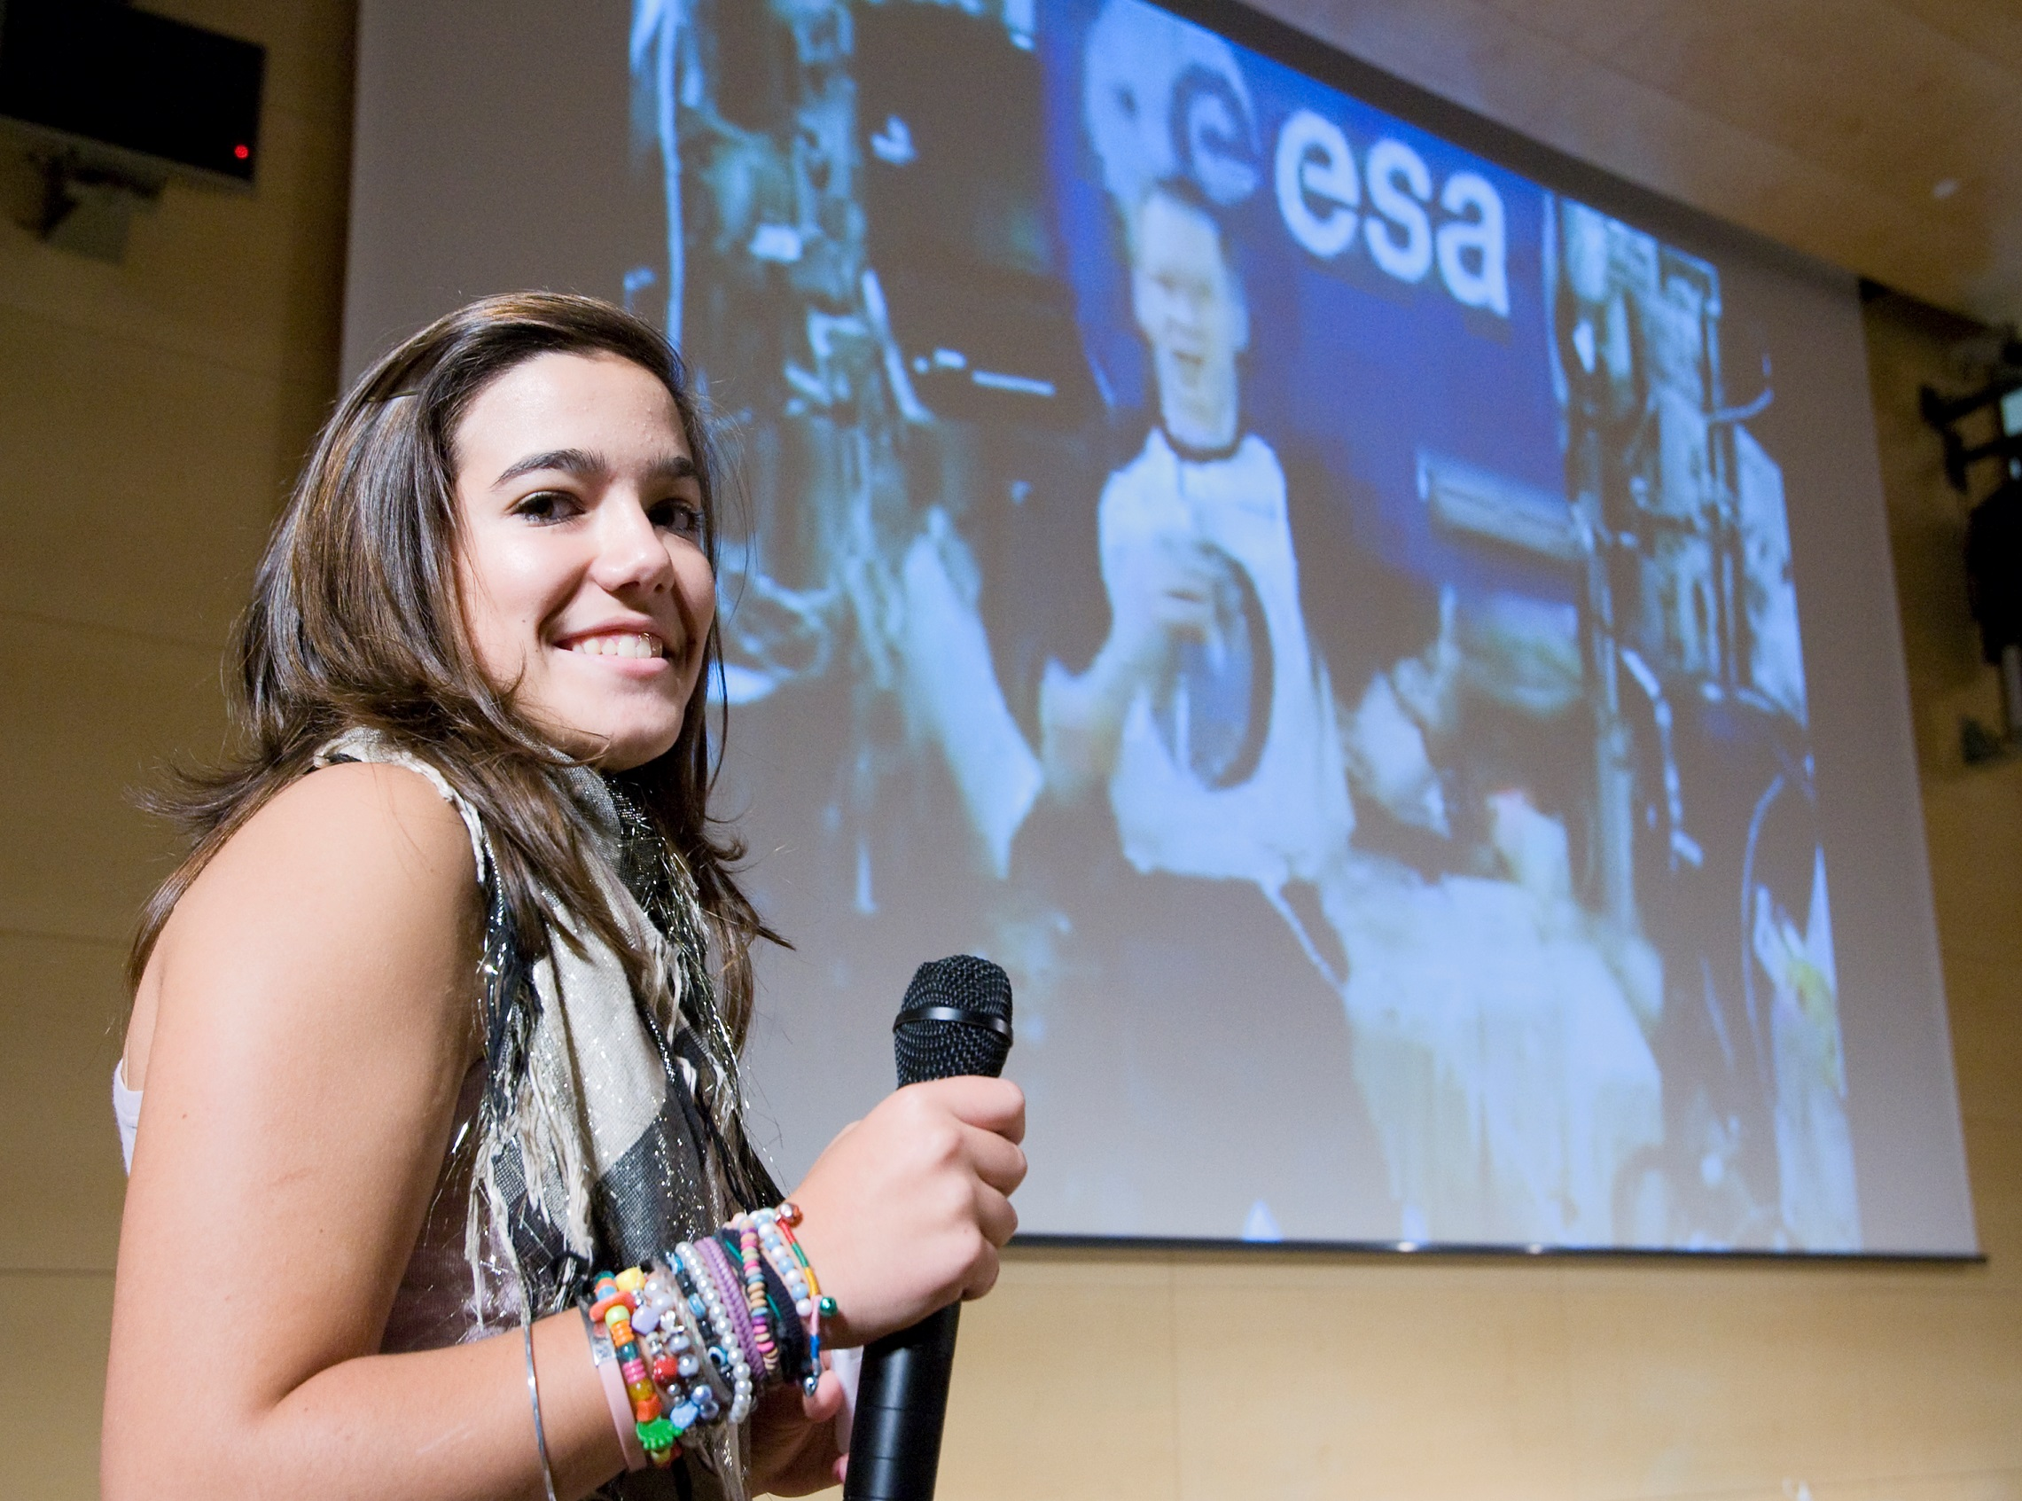
Videoconference with the ISS

Slide 31
SCIENTIFIC SHORT FILMS
Gravedad cero 2016 ( Zero Gravity)
https://drive.google.com/file/d/1YN_lrHFGiqKsI2iFK_qlt_kllJ1JBI98/view?usp=sharing
Ciencia sin límite 2017 (Science without limit)
https://www.youtube.com/watch?v=g201gS2nysc
Ciencia i espacio 2018 ( Science and Space)
https://www.youtube.com/watch?v=m1hDbSPHpUs&feature=share

Slide 32
Design and construction of an aerodynamic water rocket

Slide 33
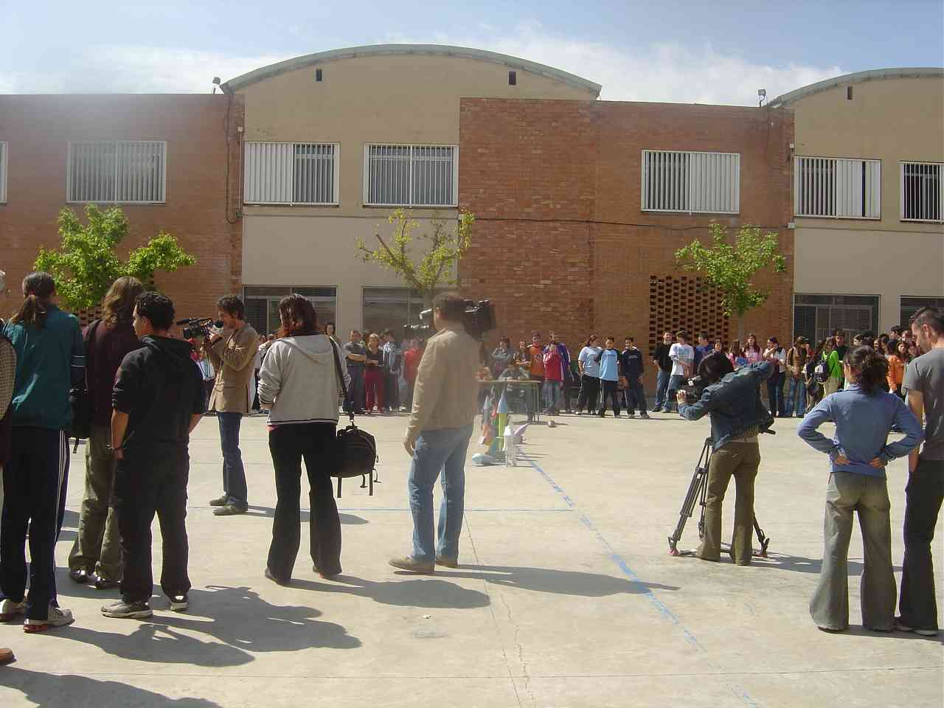
Newton’s Laws
First European Day for the Youth. Different mass media representatives interested in the science of rockets. l´Institut Guindàvols. 21st April 2005

Slide 34
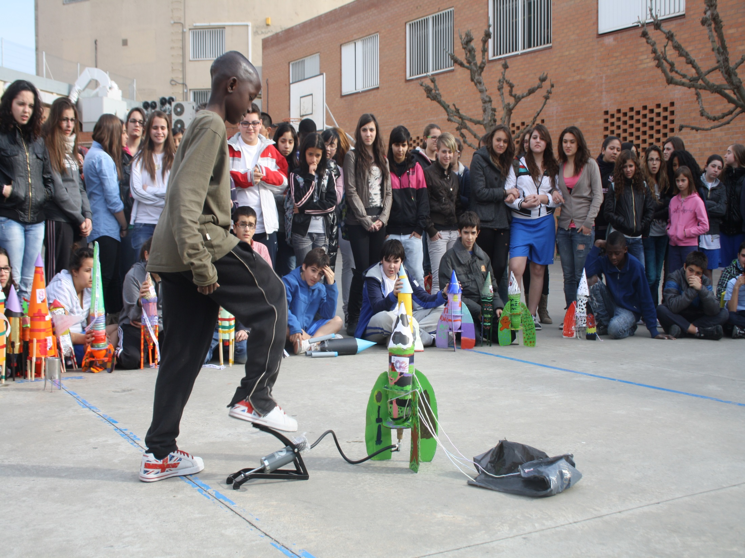
ROCKETS FOR GENDER EQUALITY
8th March : International Women’s Day

Slide 35
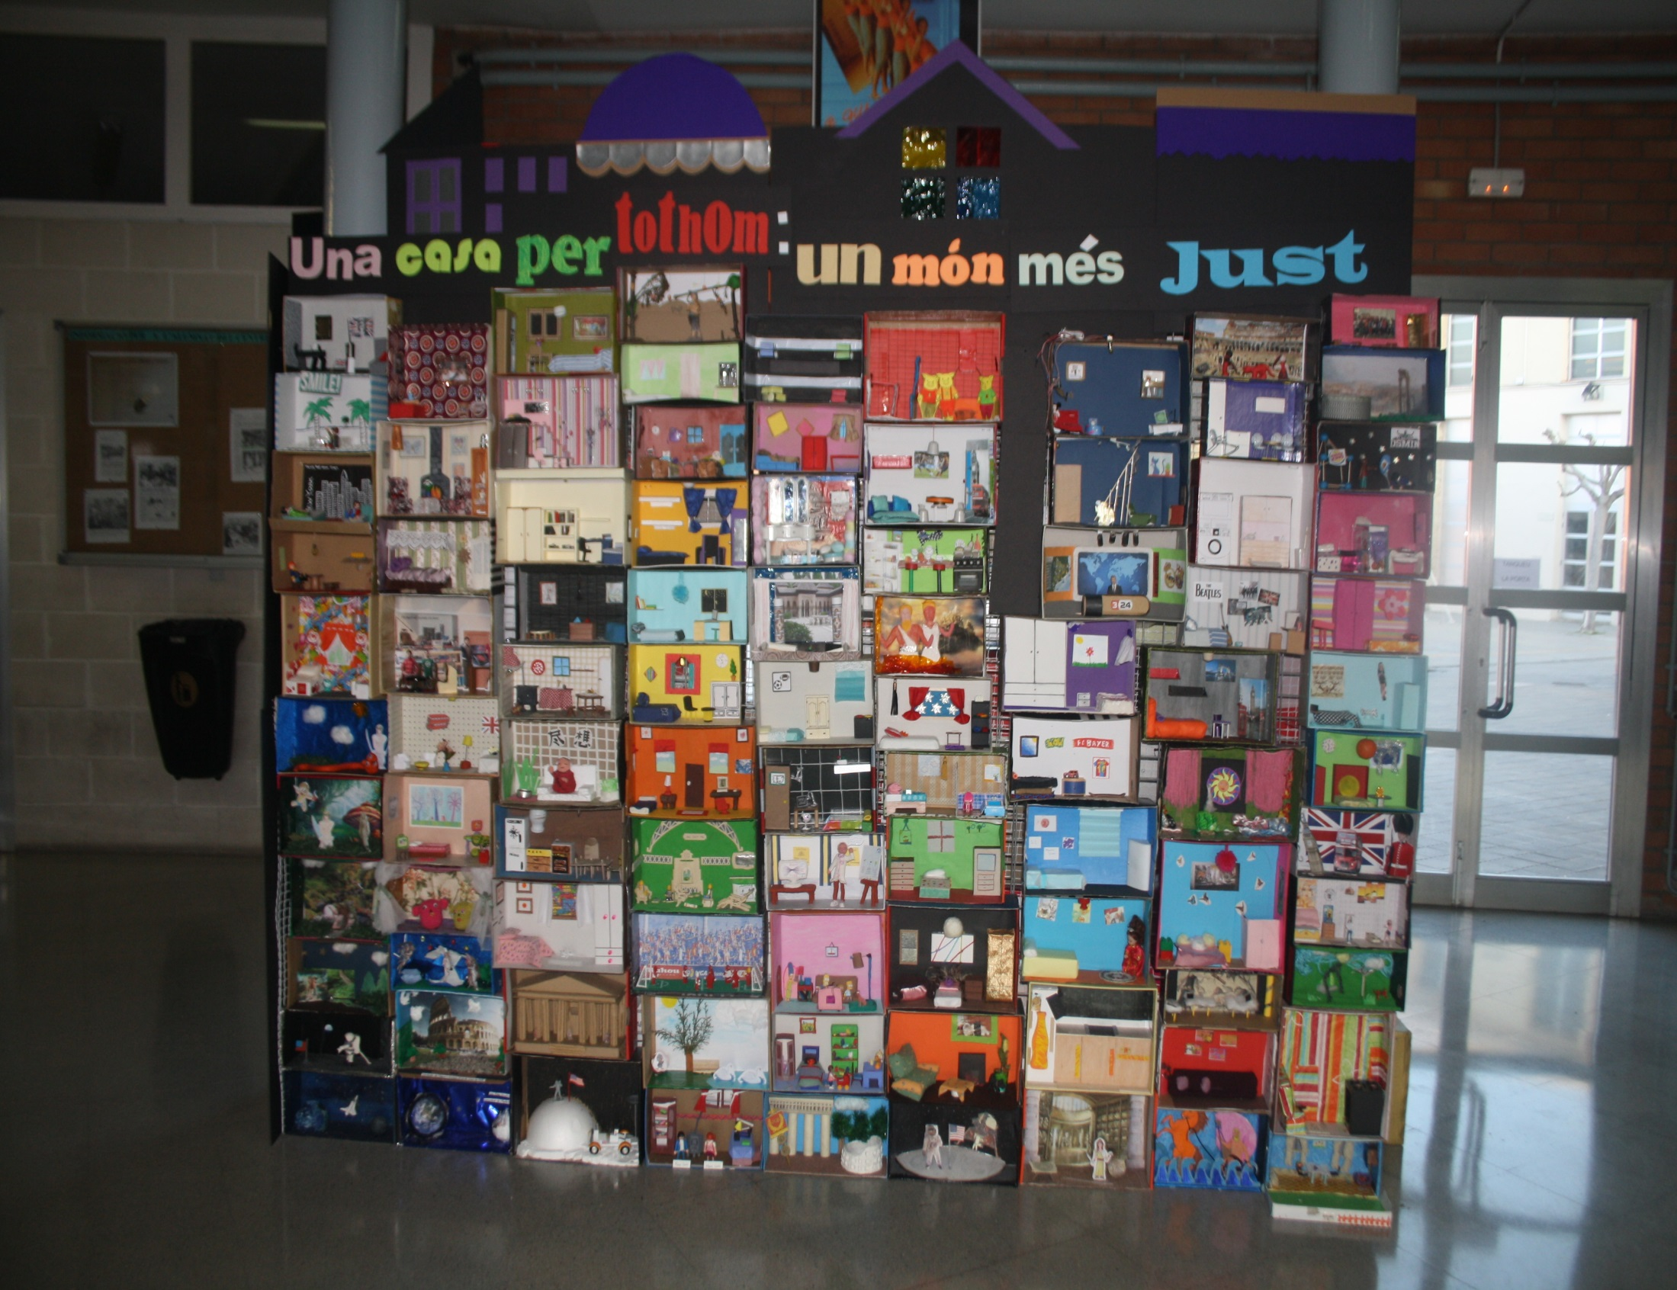
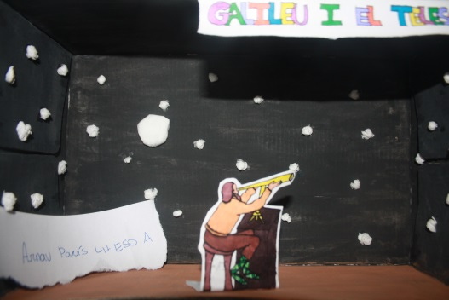
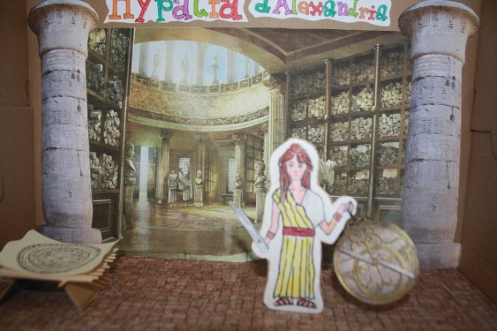
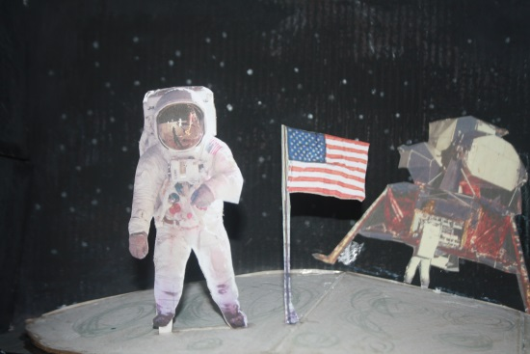
8th March 2014

Slide 36
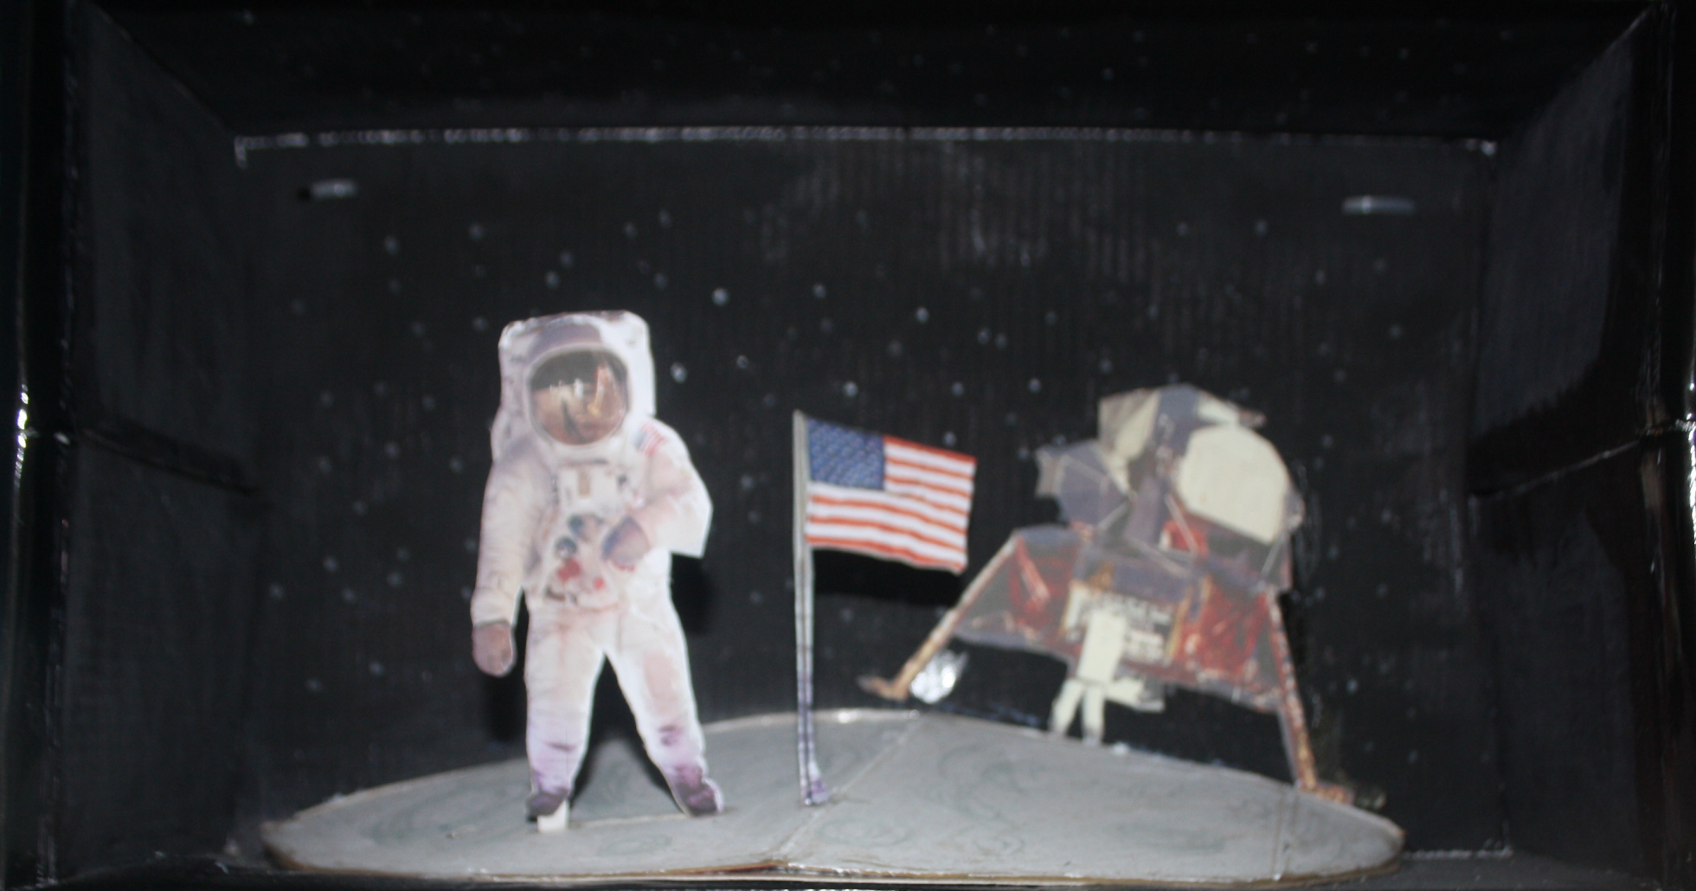

Slide 37
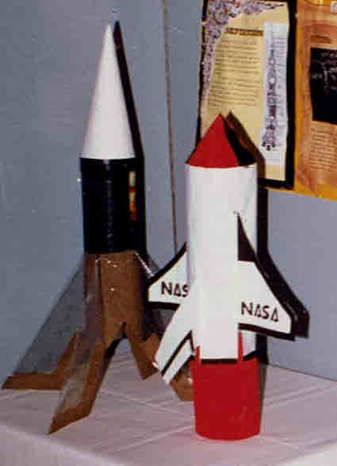
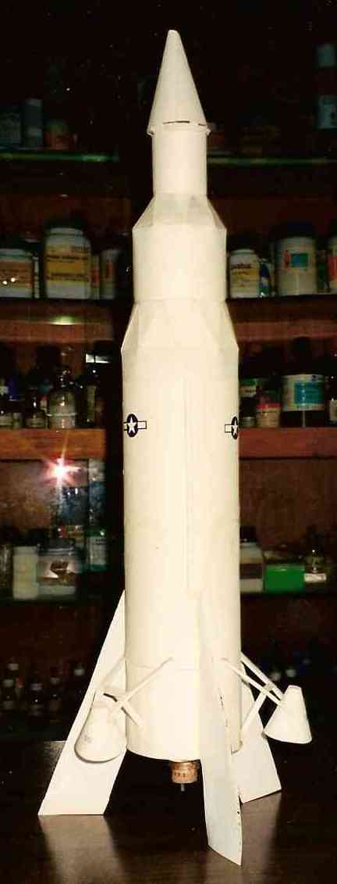
Model of Saturn V (Apolo XI)

Slide 38
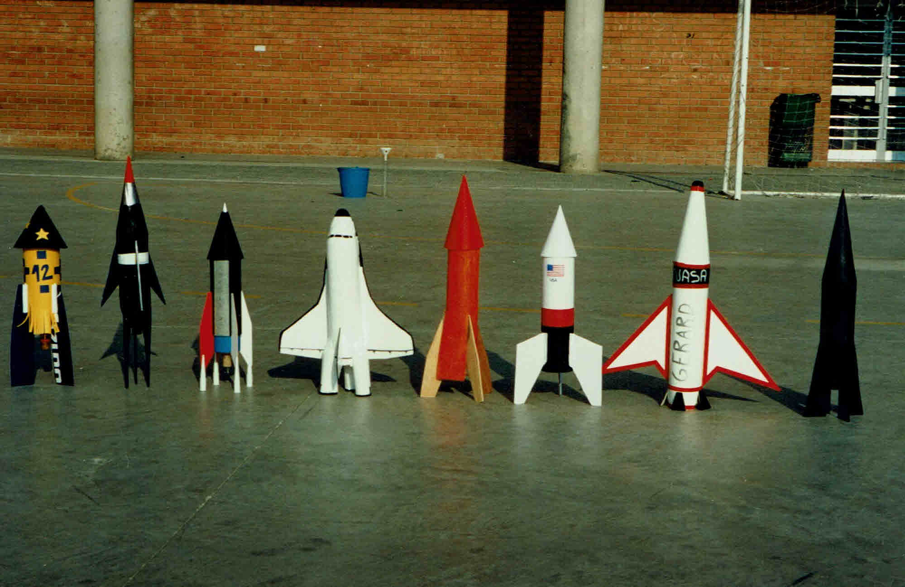

Slide 39
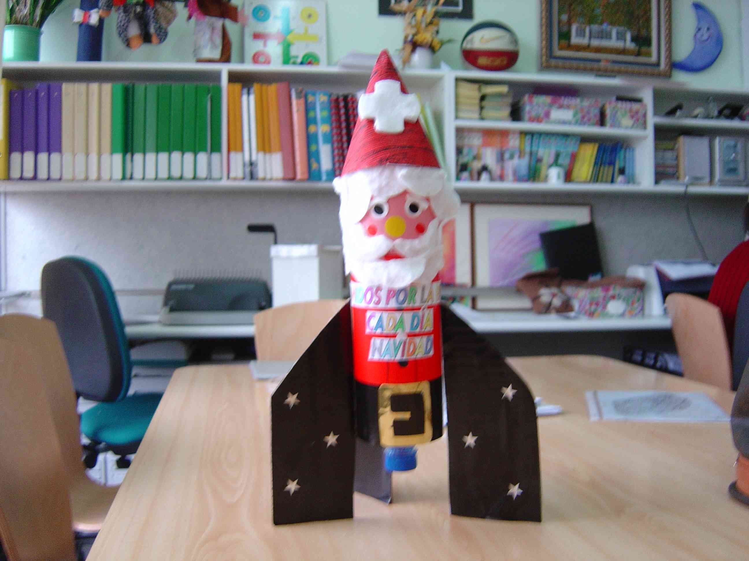
Aula hospitàlaria Arnau de Vilanova Hospital in Lleida.
Together for Peace . Christmas is every day-

Slide 40
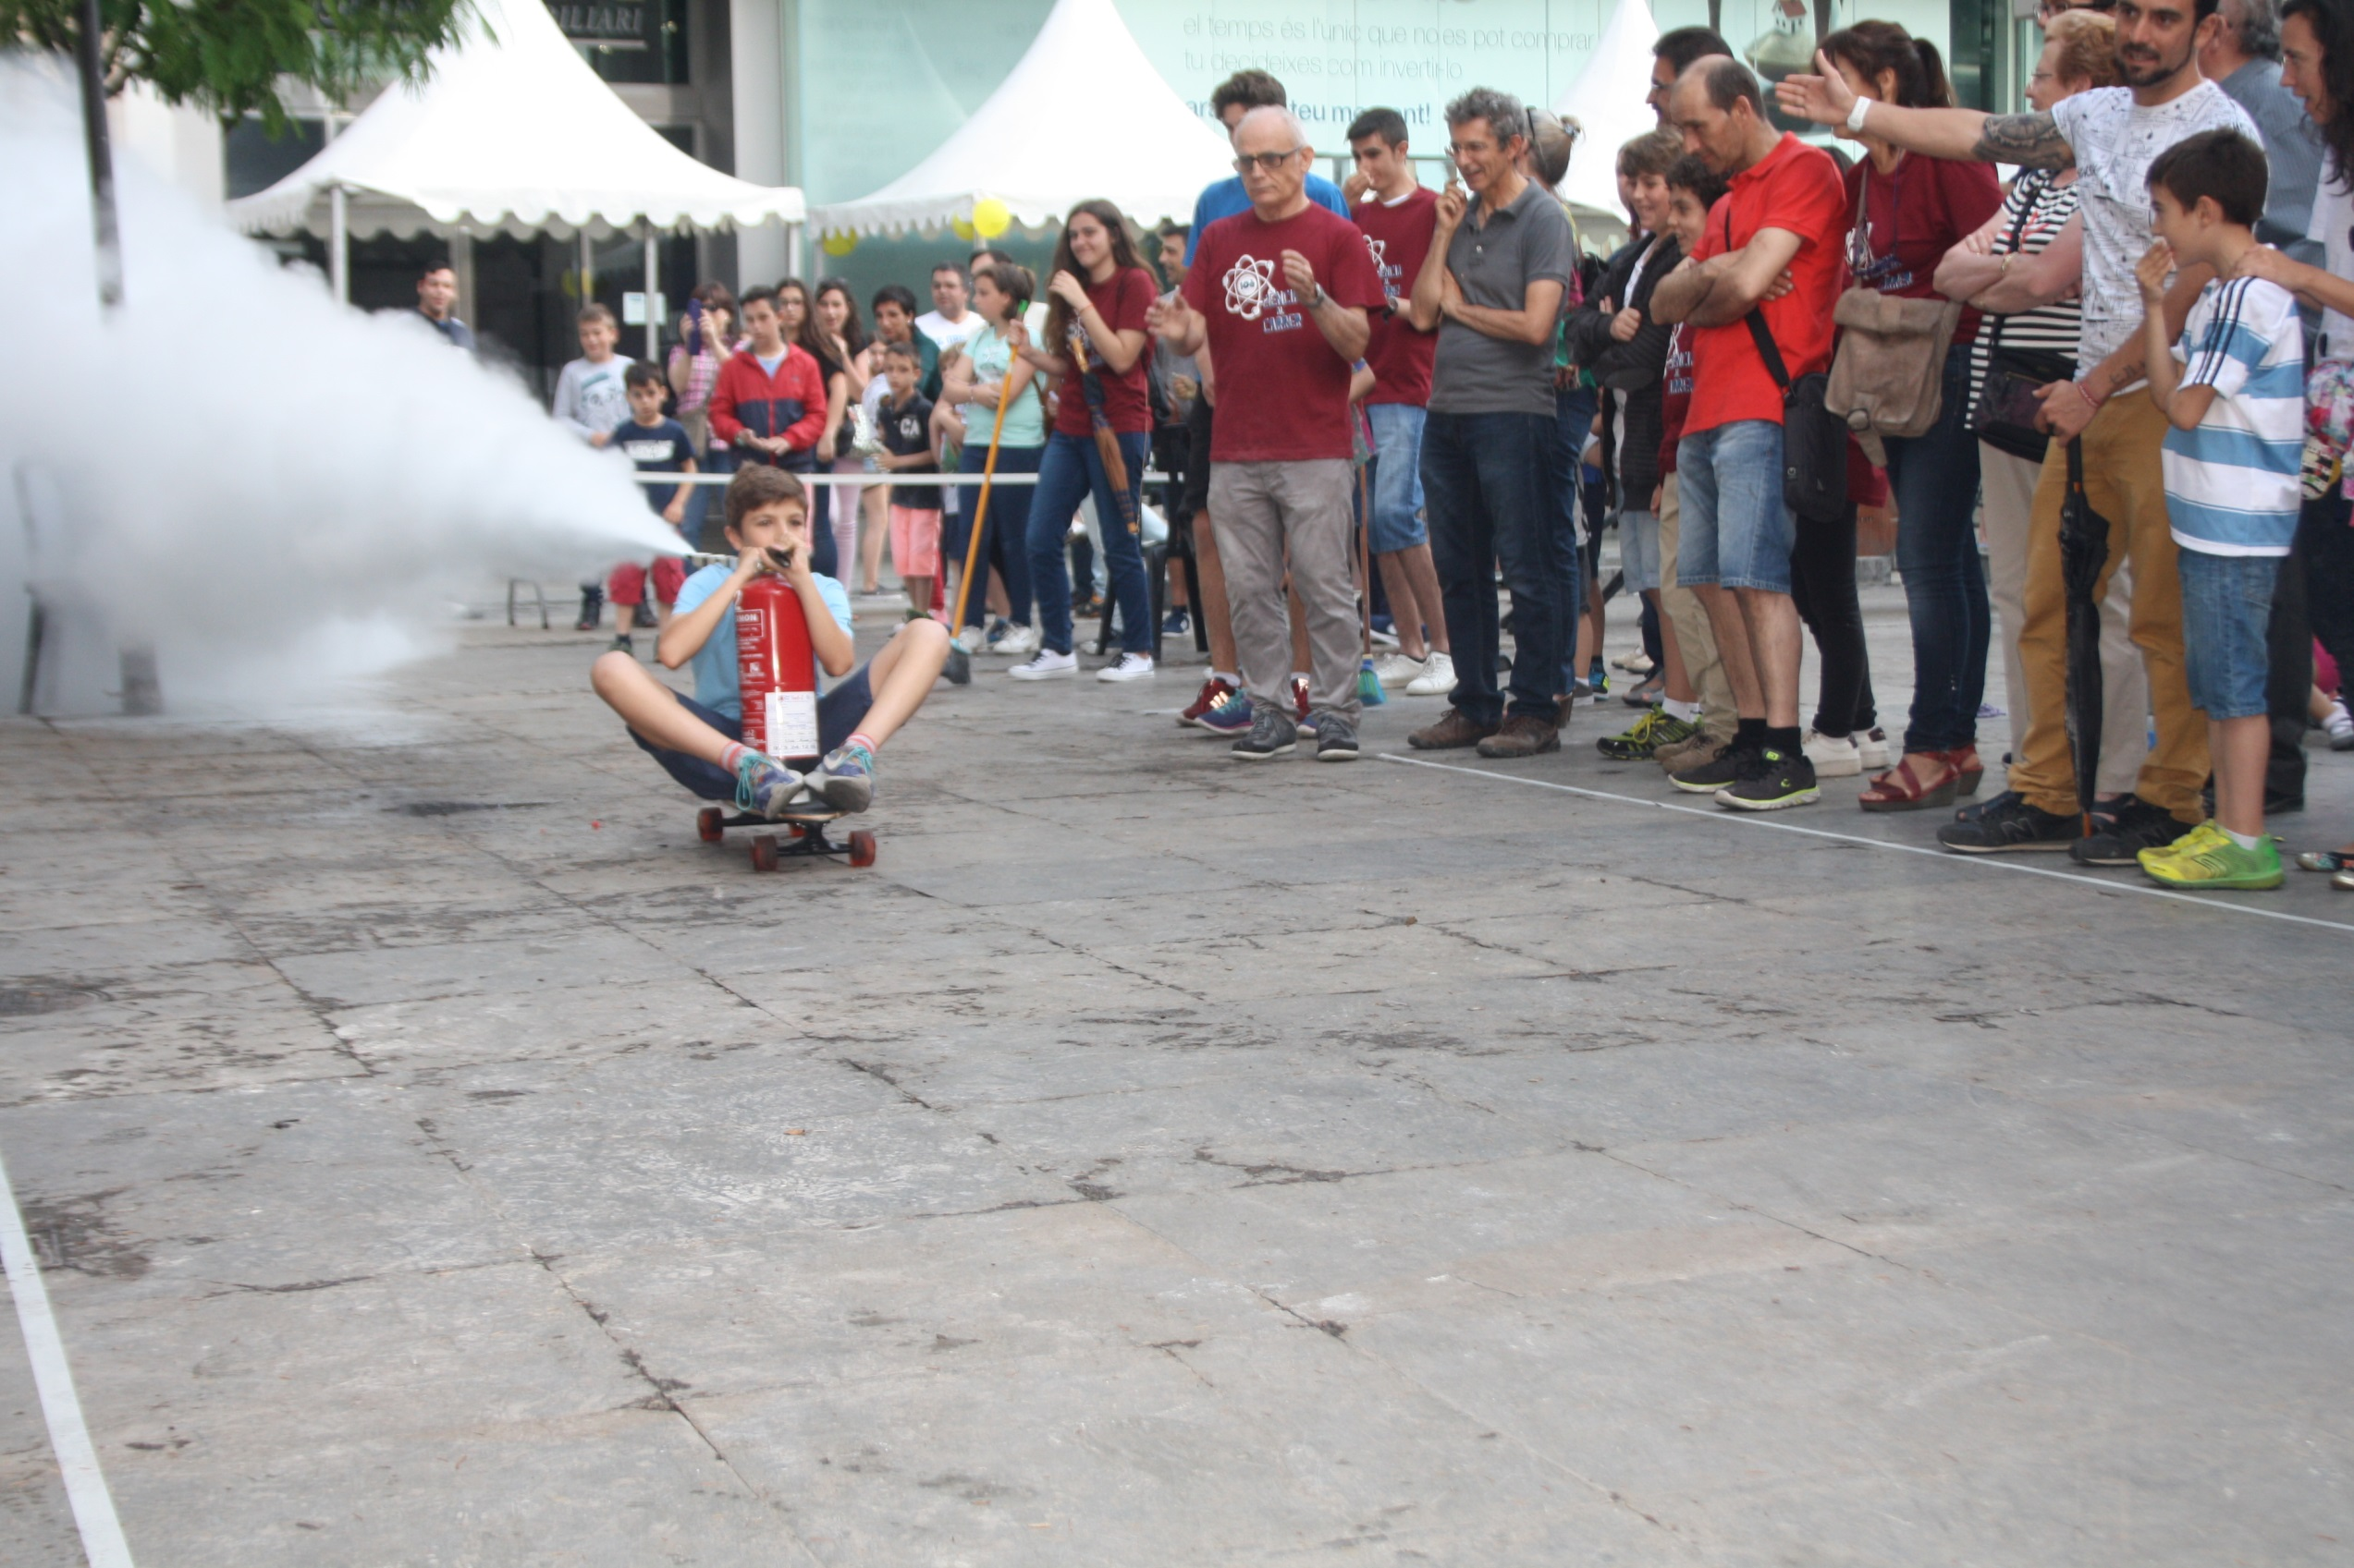
Third Newton’s Law
Science on the Streets 2016

Slide 41
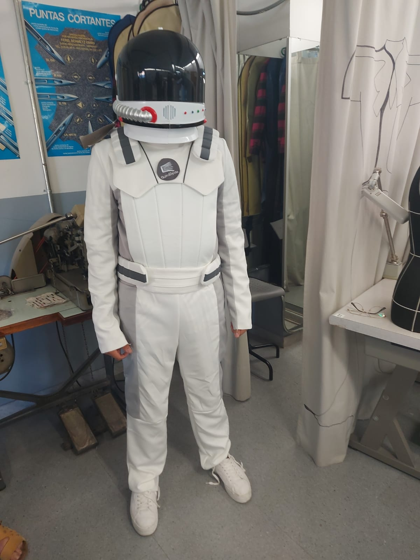
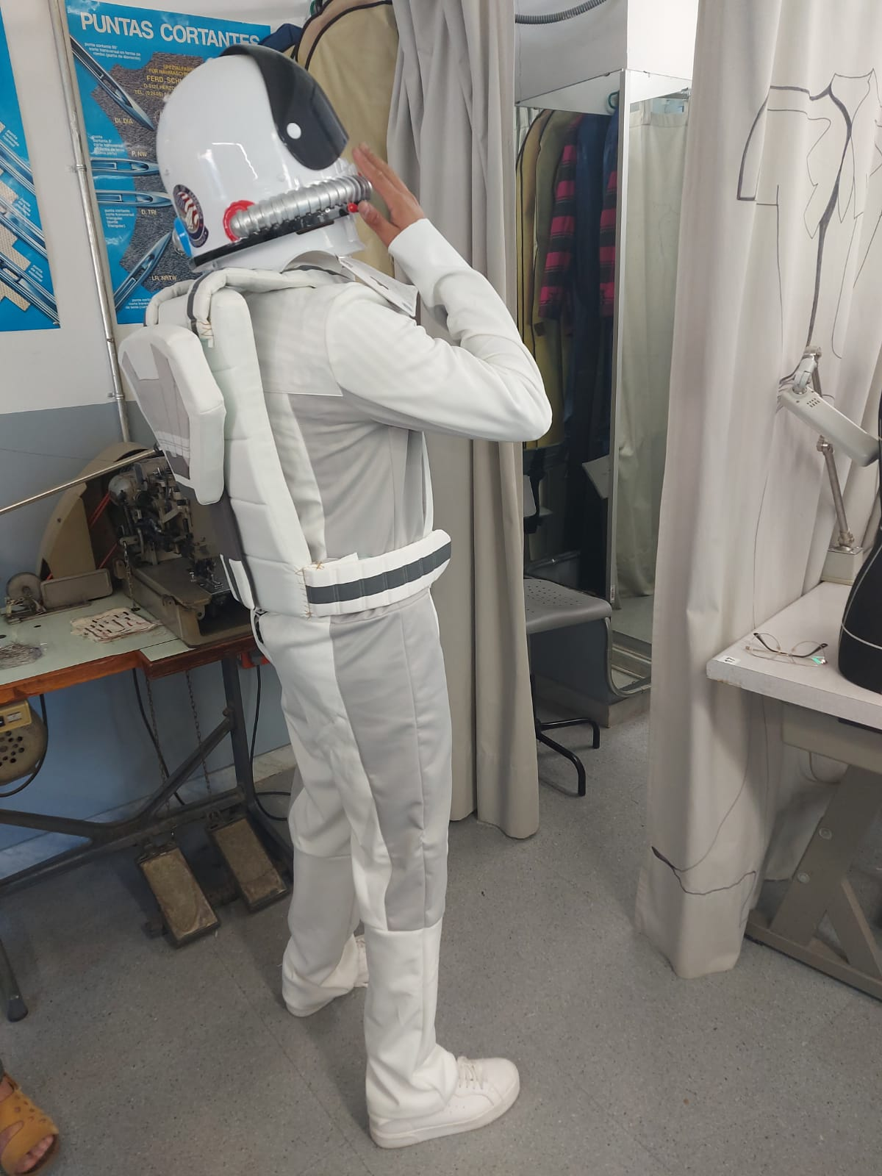
Design and making of a space dress

Slide 42
VESTITS ESPACIALS SMART MOBILITY
Departament de Moda
Vestuari d’espectacles

Slide 43
Equip i procés de treball
Estudi del projecte
Disseny dels models
Fitxes tècniques
Tria de materials i màquines
Patronatge
Marcada i tall
Confecció
Proves i rectificacions
Acabats

Slide 44
Moodboard (mur d’inspiració)

Slide 45
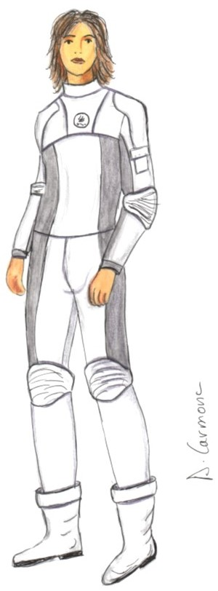
Dissenys de figurí i detalls motxilla

Slide 46
Fitxes tècniques

Slide 47
Fitxes tècniques

Slide 48
Patronatge
Motxilla
Cos i màniga
Pantalons

Slide 49
Tall de patrons i preparació de material

Slide 50
Marcada i tall

Slide 51
Confecció

Slide 52
Brodats

Slide 53
Proves i rectificacions

Slide 54
Resultat final

Slide 56
DISSENY I CONFECCIÓ DELS EMUs:
Anna Vallabriga (Professora)
Judit Guitart
Antonia Carmona
Xènia Villaró

Slide 59
Quadrúpede Lunar
Alumnat de tecnologia de 1r de batxillerat
Professor: Pere Picoy

Slide 60
Students explainig the project

Slide 61
Remembering old European mobilities

Slide 64
lllll

