Slide 1
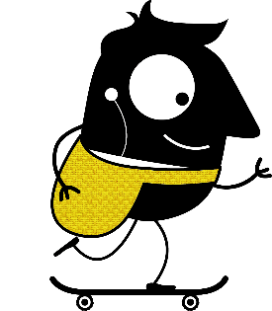
“My country, my city, my school“
Riga Secondary School No.18
November, 2019

Slide 2
LATVIA

Slide 3
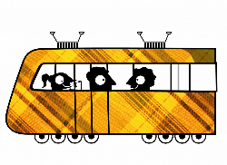
IMPORTANT FACTS ABOUT LATVIA
Latvia is located in the north of Europe;
Our neighbour countries are: Russia, Estonia, Lithuania and Belarus;
Latvia is one of three Baltic states.

Slide 4
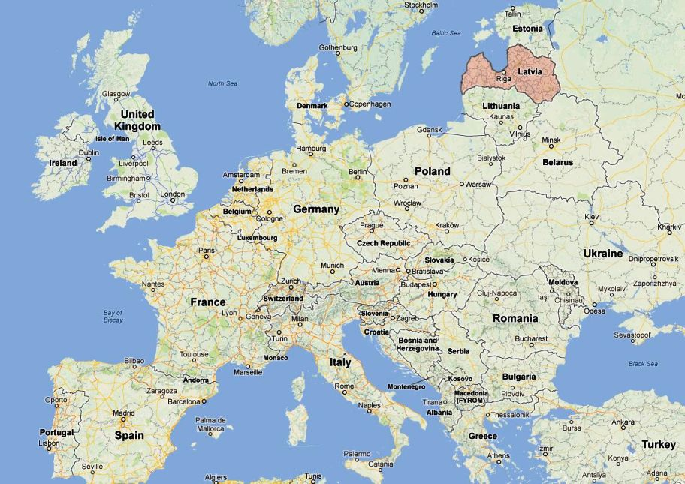

Slide 6
LATVIAN FLAG

Slide 7
LEGEND ABOUT LATVIAN FLAG
Latvian flag - carmine red with white, first mentioned in the 13th century. Latvian flag is the 3rd oldest flag in the world;
A legend refers to a mortally wounded chief of a Latvian tribe who was wrapped in a white sheet;
The part of the sheet on which he was lying remained white, but the two edges were stained in his blood.

Slide 8
MORE IMPORTANT FACTS ABOUT LATVIA
Capital city – Rīga;
Latvia was established in 1201 by German bishop Albert;
There are about 2 million inhabitants living in Latvia.

Slide 9
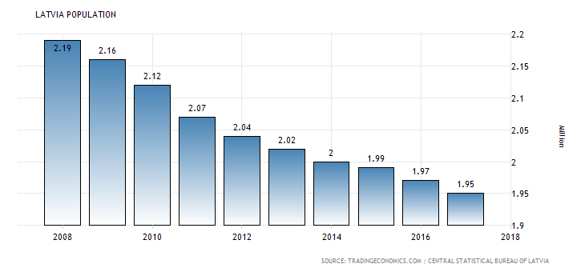

Slide 10
Riga

Slide 11
HISTORY
The history of Riga, the capital of Latvia, begins as early as the 2nd century, when here lived Livs;
First arrival of German merchants started Christianization.

Slide 12
HISTORY
In 1207, Bishop Albert started on fortification of the town;
In 1211, Riga minted its first coinage, and Bishop Albert laid the cornerstone for the Riga Dom.

Slide 13
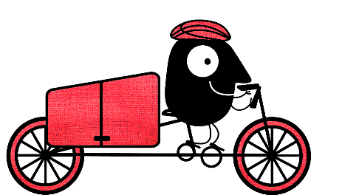
INFO ABOUT RIGA
Population: around 730,000~ inhabitants;
It is also the largest city in the Baltic states;
Home to one third of Latvia's population.

Slide 14
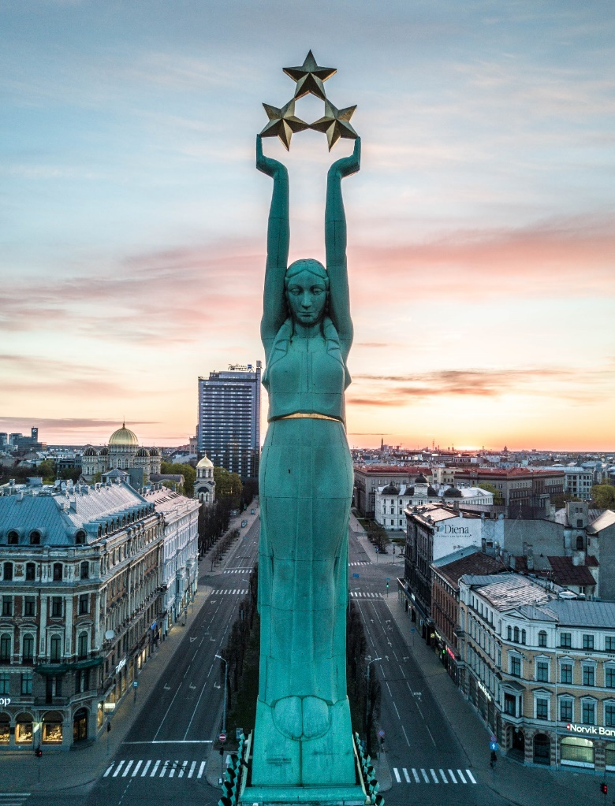
TOP PLACES IN RIGA
Old Riga
The Freedom Monument

Slide 15
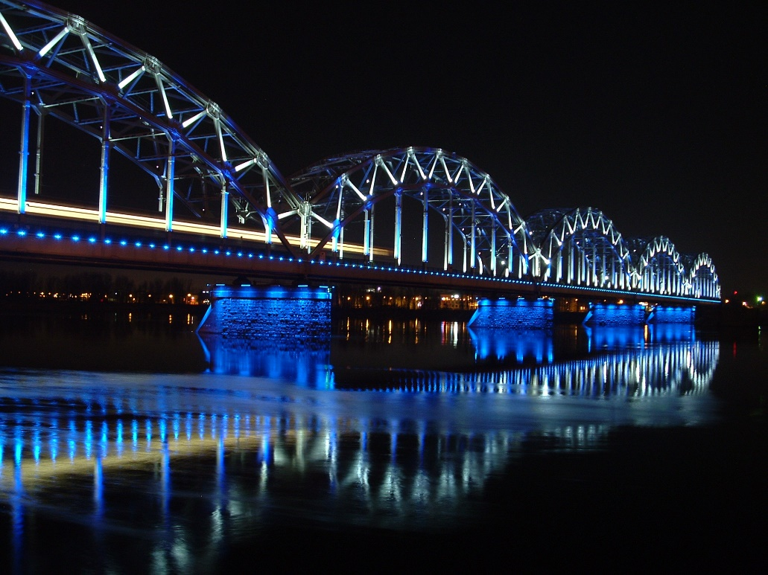
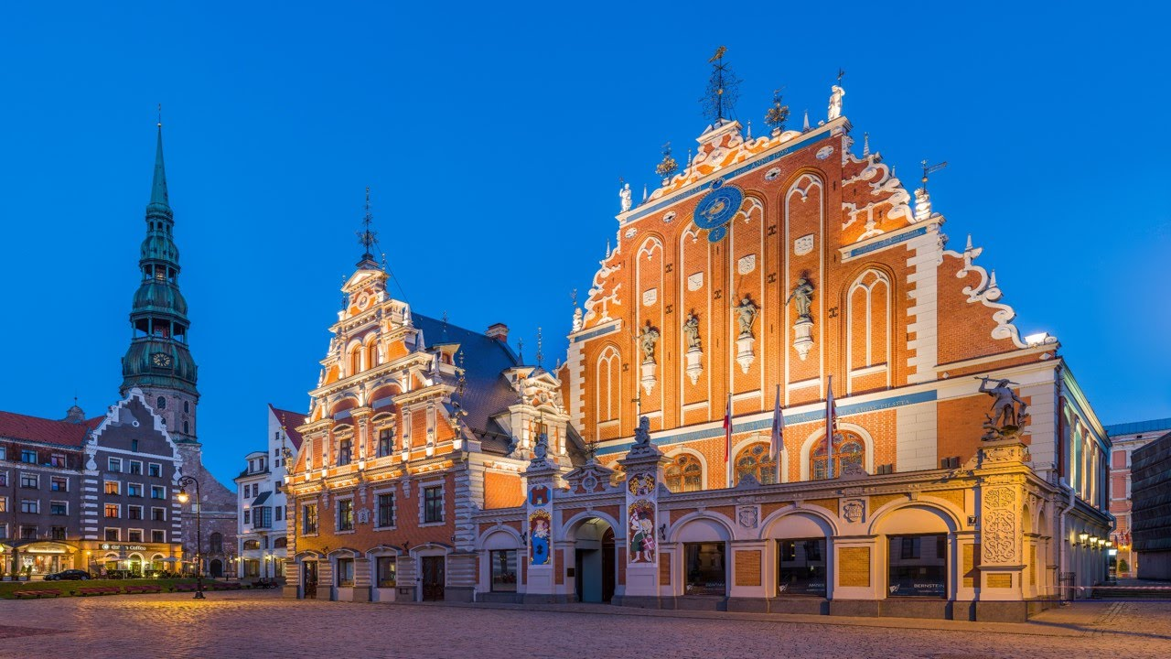
Railway bridge
House of Blackheads

Slide 16
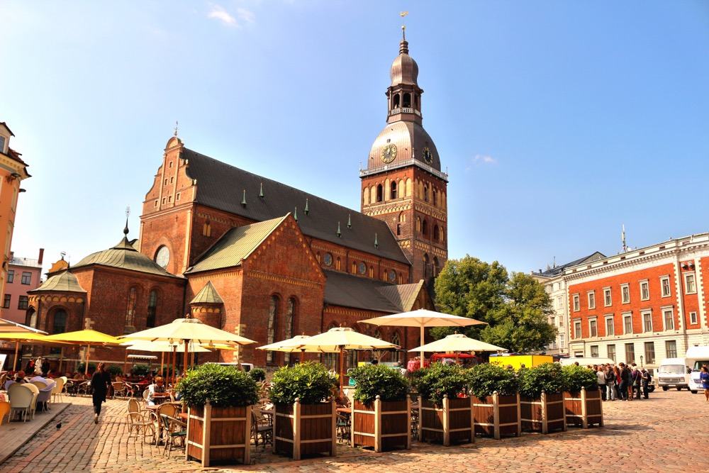
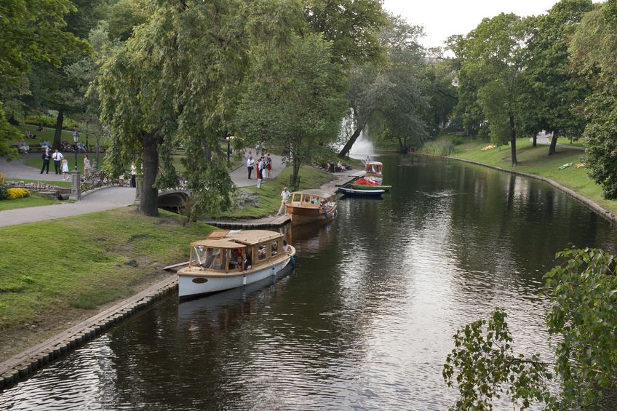
Riga Dome Cathedral
Riga Canal

Slide 17
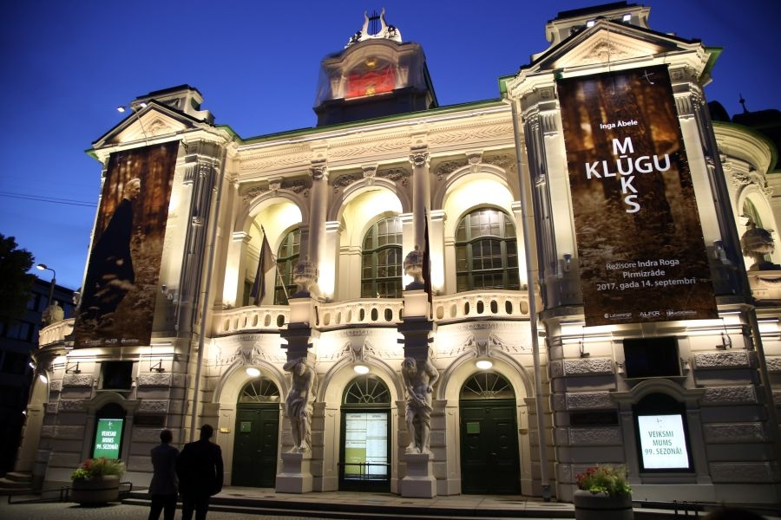
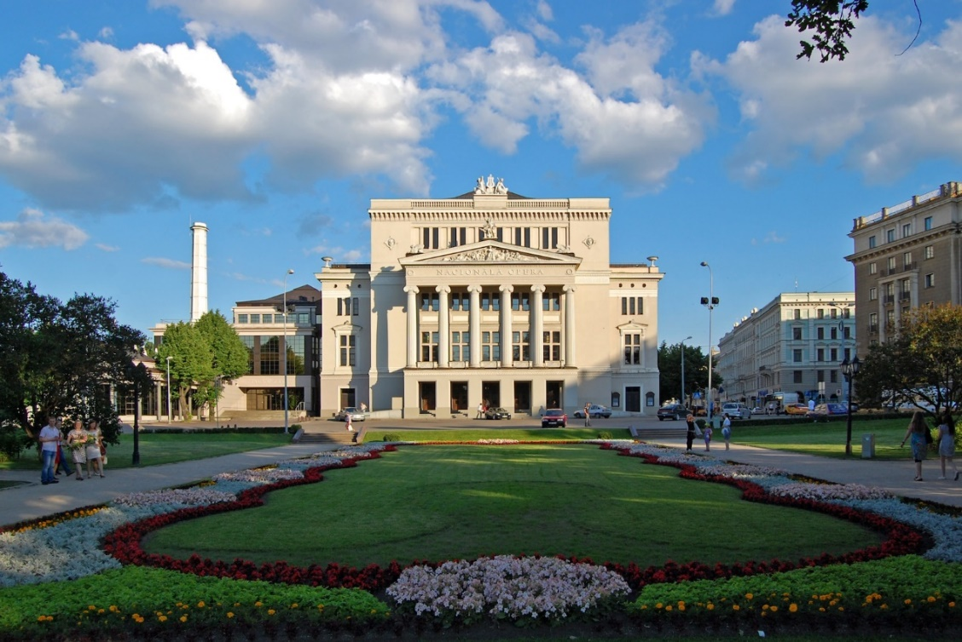
Latvian National Theatre
Latvian National Opera

Slide 18
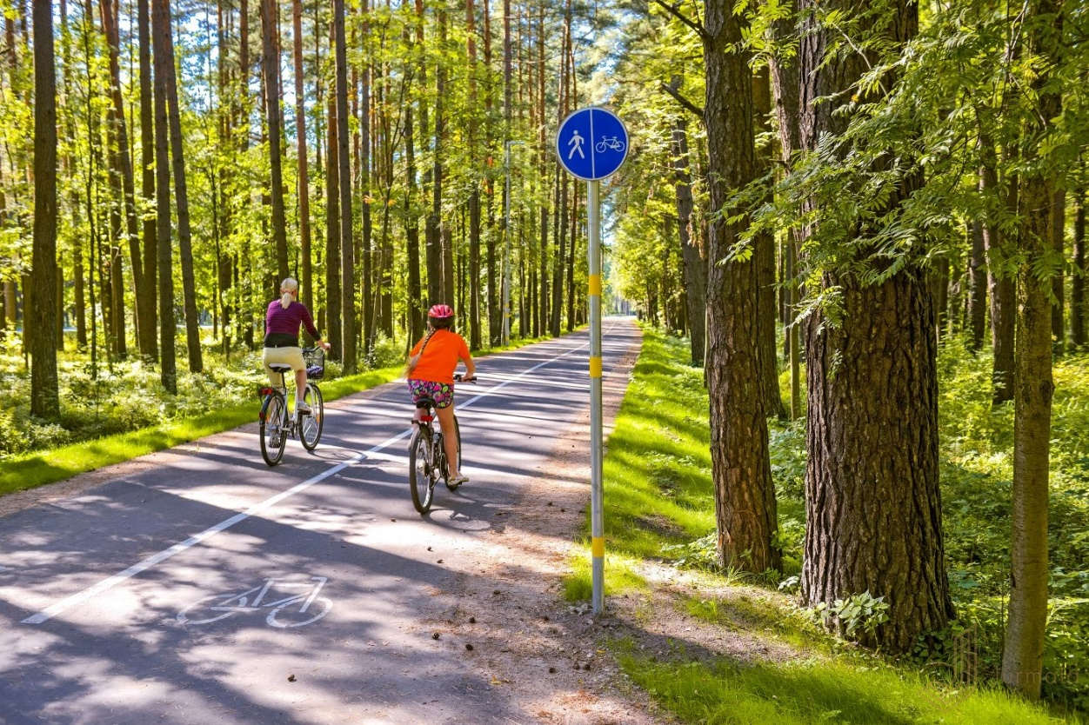
SUSTAINABILITY IN RIGA
During the last 10 years more than 150 kilometers of bysicle roads have been built in Riga connecting most areas of the city.

Slide 19
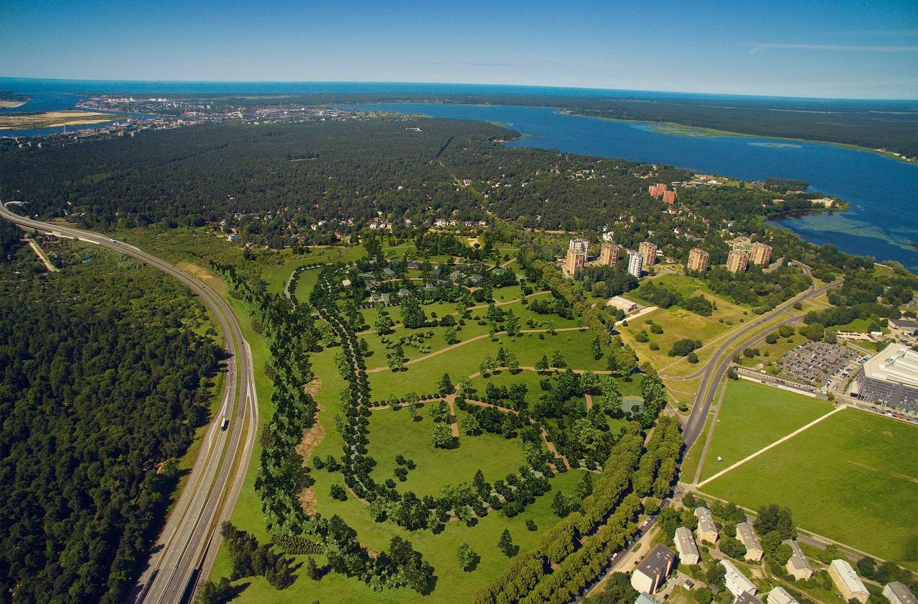
SUSTAINABILITY IN RIGA
Riga provides possibilies to do sports and follow and active lifestyle, because of 22 parks all around the city, biggest of which is Mežaparks – 12km2. That also includes a spectacular zoo!

Slide 20
SUSTAINABILITY IN RIGA
Municipality is organizing health related free of charge sport activities outdoors under the guidance of professional fitness trainers.
Activities are for all age group people and are happening in the parks of Riga or in the sand beaches.

Slide 21
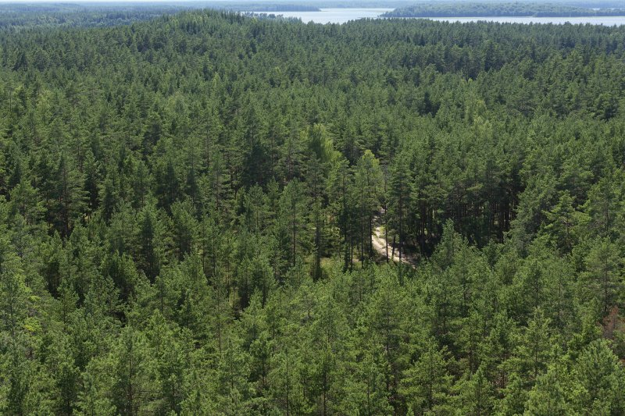
SUSTAINABILITY IN LATVIA
57.1% of Latvia is covered in woods, making it 5th greenest in Europe, way over average EU of 41%.
During the last 20 years woods in Latvia have expanded for 15,6%

Slide 22
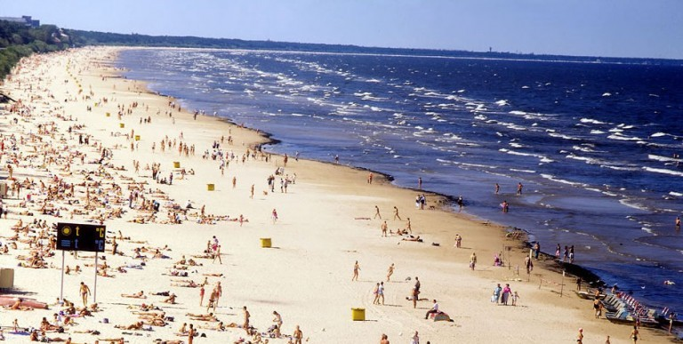
SUSTAINABILITY IN LATVIA
Air quality in Latvia is great because of the woods and sea coast, that is 531 km large, almost all of it covered with nice, white sand.

Slide 23
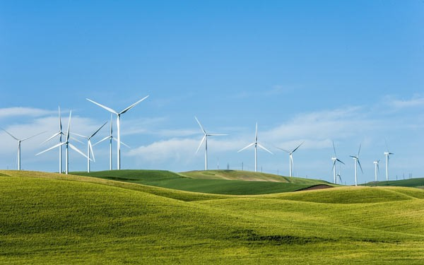
SUSTAINABILITY IN LATVIA
+ WIND energy 2% of total produced in Latvia and is set to increase in coming years;
+ Unlimited source of energy;
+ Getting more popular and great example in neighbours – Lihuania 27%.

Slide 24
Sustainable development strategy of Latvia until 2030
The basic idea of sustainable development invites to satisfy the needs of the present generation, balancing public welfare and environmental and economic development interests and concurrently ensuring the observation of the environmental requirements and the preservation of natural diversity in order to avoid the reduction of possibilities to satisfy the needs of future generations.
Priorities:
Sustainable Management of Natural Values and Services;
Inovative and eco-friendly economy;
Nature as a future capital.

Slide 25
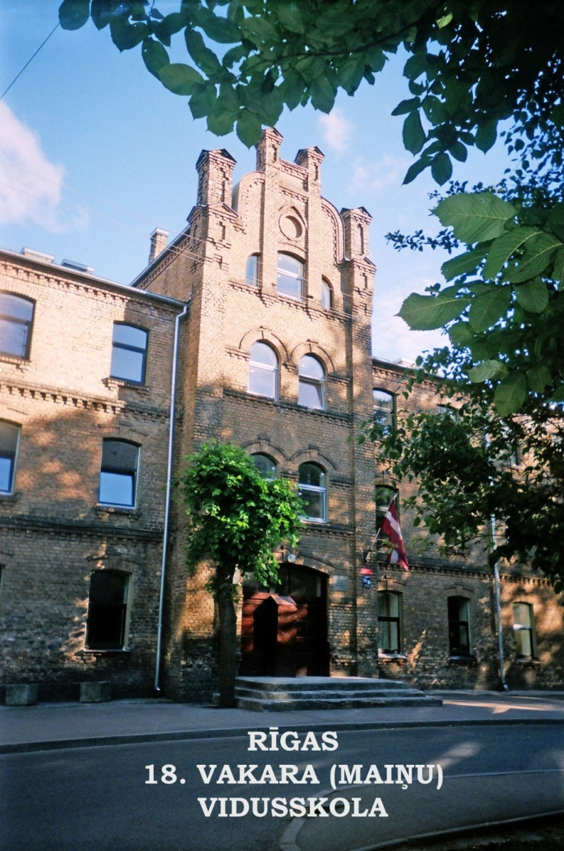
My School

Slide 26
SCHOOL HISTORY AND TRADITIONS
The school was built in 1895;
The school started in 1934;
In the meantime there are 530 students aged from 11 to 45 and about 45 teachers.

Slide 27
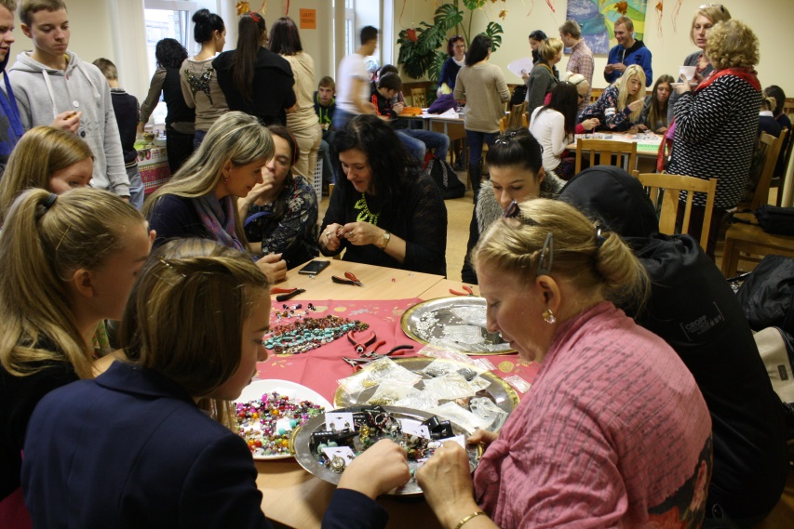
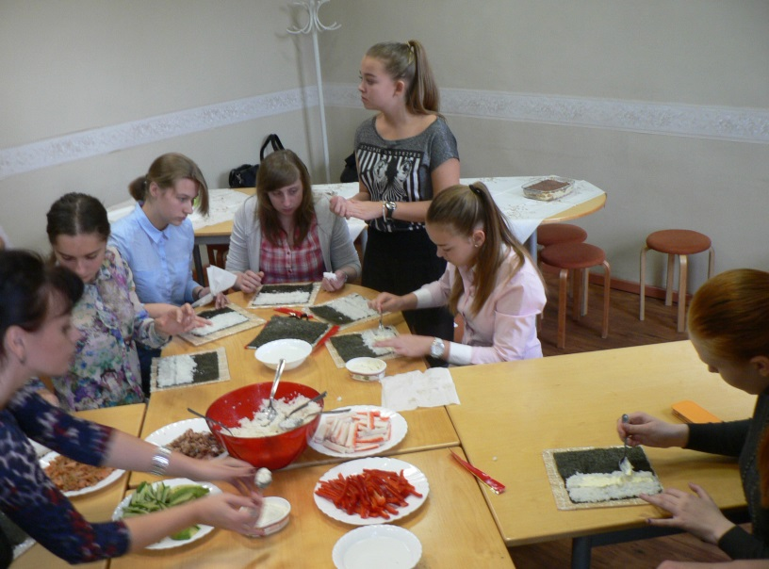
MISSION OF SCHOOL
Our school educates and offers help
to students solving different kinds of problems, either social or educational.

Slide 28
COOPERATING ON PROJECTS
Our school has been winning contests and implementing varied projects for many years now;
Historically our city has always been a culturally and ethnically mixed one, so city council financially supports projects aimed at social integration.

Slide 29
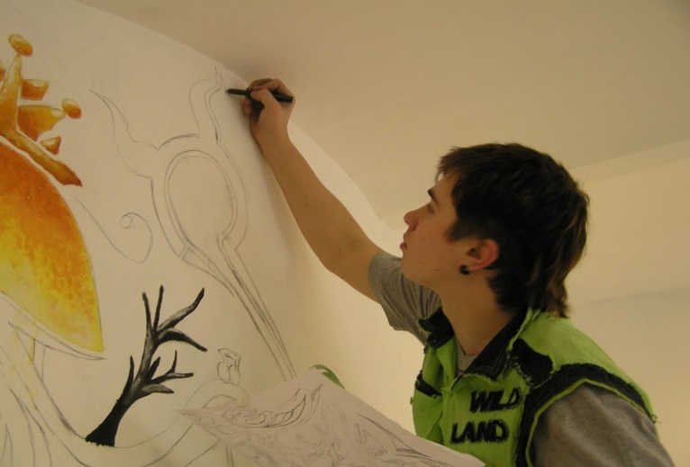
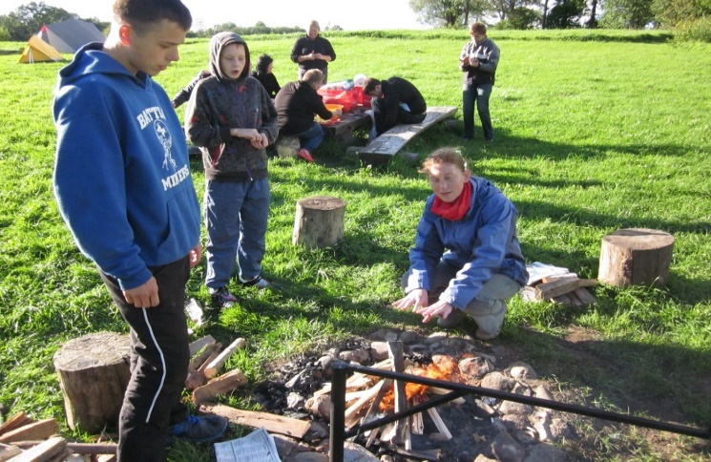
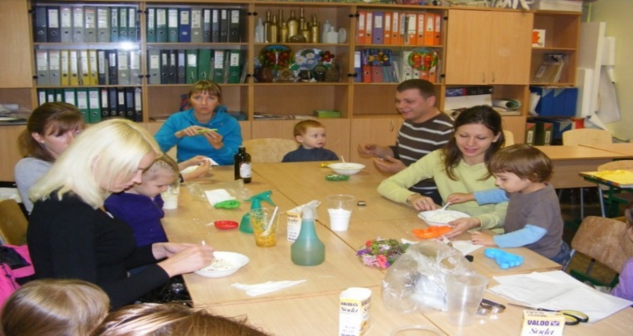
COOPERATING ON PROJECTS
«Common air»
About family values-
«Happy family»
«Create - enjoy»

Slide 30
COOPERATING ON ERASMUS + PROJECTS
1) My Micro-region in Macro-Europe. A Young European in Restructured Space (2016 – 2019).
2) We are different, we are Europe all together (2017 – 2019).
3) Art and ICT, against bullying & cyberbullying. (2017 – 2019).
4) Ready Steady Start (2017 – 2019).
5) Technology addiction in adolescents (2018-2020)
6) Smart mobility 2.0 (2019-2021)

Slide 31
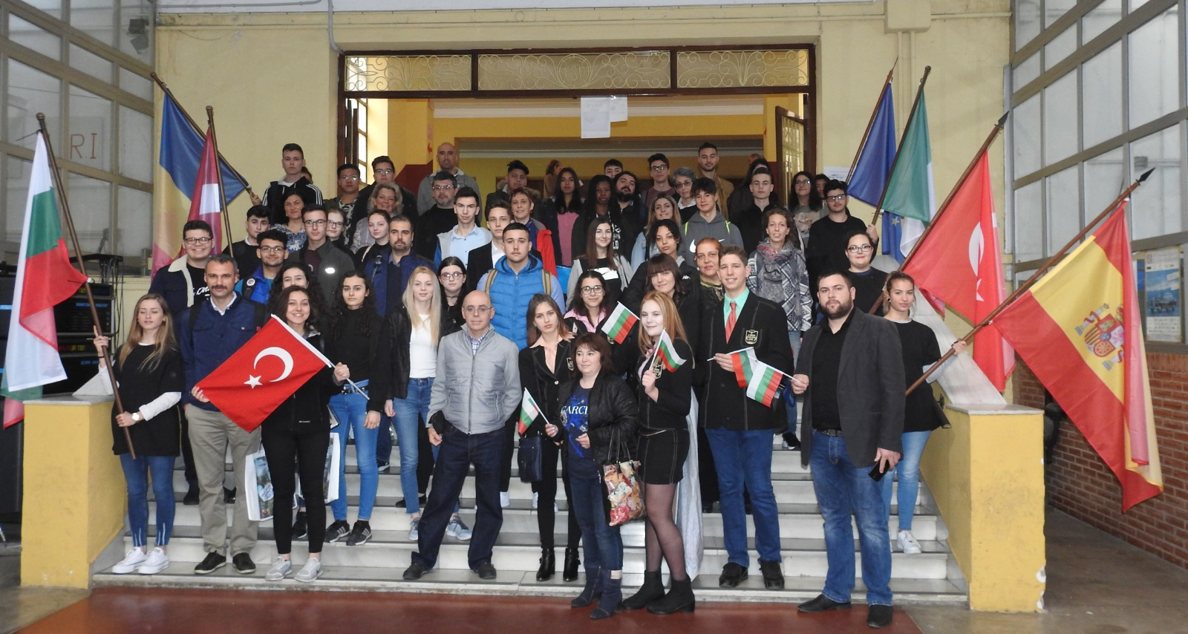
COOPERATING ON ERASMUS + PROJECTS

Slide 32
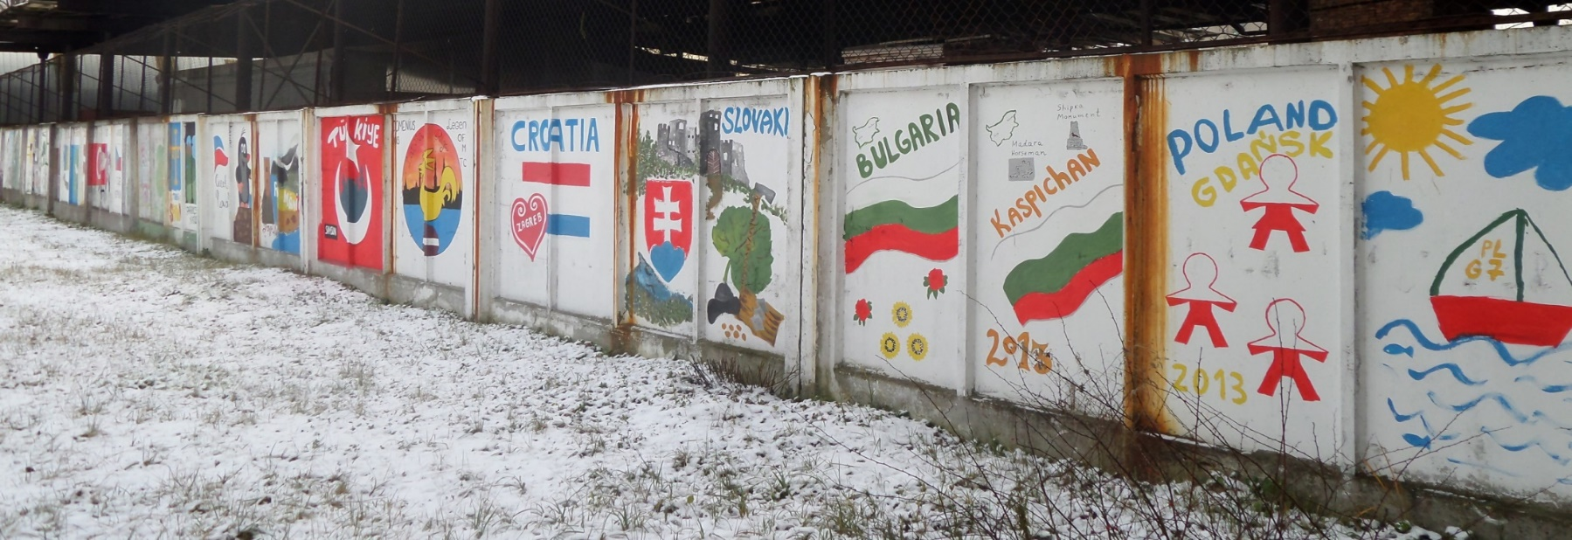
COOPERATING ON EU PROJECTS
Best memories about our European friends…

Slide 33
Thank you for your attention!

