Slide 1
Brussels visit benefit
Eva-Maria`s selection

Slide 2
CoR (Ausschuss der Regionen AdR) - facilitating mobility by EGTC interesting for Pozallo??
37,5% of EU citizens live in border areas, e.g. people in Catalonia
the EGTC European Grouping of Territorial Cooperation (EGTC) today 73 are existing
is the first European cooperation structure with a legal personality defined by European Law
EGTC Eurodistrict Strasbourg –Ortenau
Cross-border Tramway connecting Strasbourg (F) and Kehl (Germany) under French rules
tourisme services Chaves-Verin( Portugal-Spain)
2 EGTCs have been involved in implementing Research and Innovation strategies for smart specialisation in 2016
fo

Slide 3
EESC: European Economic and Social Committee – the voice of the civil society
It has to be involved as an advisatory body (according to EU Treaty Article 13

Slide 4


Slide 5

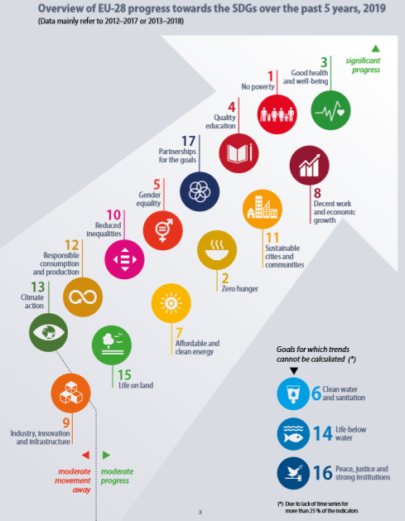

Slide 6
Example of its work
Opinions – Reflection Paper “Towards a Sustainable Europe 2030”, “Leaving no one behind”, “The sustainable economy we need”, etc.

Slide 7

It’s about Europe, it’s about YOU!
www.eesc.europa.eu
Visit our
website and
find us on
social media
www.eesc.europa.eu/facebook
www.eesc.europa.eu/twitter
www.eesc.europa.eu/youtube

Slide 8

It’s about Europe, it’s about YOU!
Members’ page
www.eesc.europa.eu/?i=portal.en.members
Opinion search
http://dm.eesc.europa.eu/EESCDocument
Search/Pages/opinionssearch.aspx?culture=EN
Find out more
about our work
Plenary session summaries
http://www.eesc.europa.eu/?i=portal.en.
Documents#/boxTab1-2

Slide 9
Check your opportunities
Traineeships
http://www.eesc.europa.eu/?i=portal.en.
traineeships

Slide 10
European Commission (basic preesentation)
Protecting citizens and freedoms
Developing a strong and vibrant economic base
Building a climate-neutral, green, fair and social Europe
Promoting European interests and values on the global stage
EU 2019-2024 strategic agenda
based on https://www.consilium.europa.eu/en/eu-strategic-agenda-2019-2024/
At its meeting in Brussels on 20 June 2019, the European Council agreed on an agenda for the EU for the next five years, based on a proposal made by the European Commission.

Slide 11
European Commission
Supporting cities in transition to sustainable transport –EU urban mobility policy
Piotr RapaczCoordinator, Urban mobilityEuropean Commission, DG MOVE, Sustainable& Intelligent Transport Unit (B.4.)

Slide 12

European Commission
The Marketplace of the European Innovation Partnership on Smart Cities and Communities (EIP-SCC/Smart Cities and Communities)

Slide 13
New Apps?
6 action clusters, 6.000 partners, combining transport-energy-ICT applications.

Slide 14
EU funding: Horizon 2020
Beispiele für Leuchtturm-Projekte
https://eu-smartcities.eu
Interesting for links to Stakeholders like universities /researchers?
Heidenheim:Interessant für Cooperation mit BA???

Slide 15
Improve Cycling facilities
Guidance for cycling projects
https://ec.europa.eu/transport/themes/urban/cycling/guidance-cycling-projects-eu_en
Pilot projects:
-Raising Awareness of alternatives to private car
-Sustainable shared mobility interconnected with public transport in rural areas (SMARTA)

Slide 16
2013 urban mobility package
Need for stronger cooperation between different policy levels to deliver on sustainable urban mobility

Slide 17
Core concept: Sustainable Urban Mobility Plans (SUMPs –Annex to the Communication), big role for multimodal solutions!

Slide 18
Active citizenship at local level!
Commits to reinforced EU support for local action on urban mobility (2014-2020)

Slide 19
Active citizenship!
Seit2002 zurzeit 3100 Cities registriert
Encourage your local community to participate!

Slide 20
Sustainable Urban Mobility Plan
The SUMP concept is supported by:
➢SUMP guidelines
➢Planning tools
➢Best practice examples
➢National frameworks
-MemberStates profiles
➢City database
➢European Platform on SUMPs
-Coordination Group
SeeEltis.org –the urbanmobilityobservatory
….also for your local community?
auch für Heidenheim!

Slide 21
Informationen
EU funding! Fördermittel!
Exchange of Information & Best Practice
WWW.ELTIS.ORG
“The urban mobility observatory: facilitates the exchange of information, knowledge and experience in the field of sustainable urban mobility in Europe”

Slide 22
EP still missing

